Slide 1
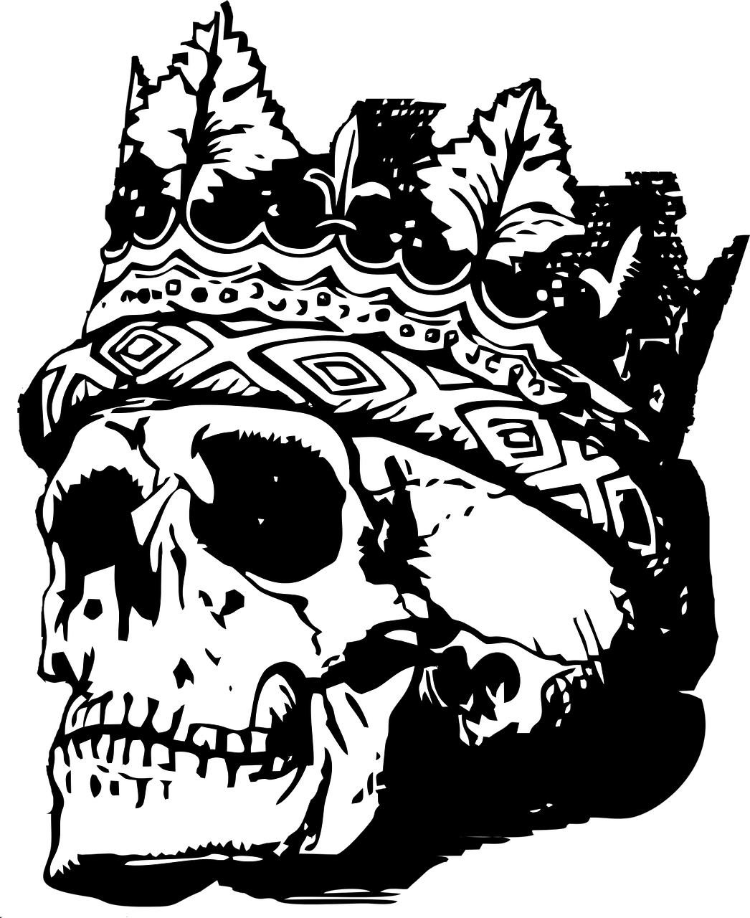
Learning outcomes
To describe the key qualities of kingship and the type of character Malcolm is
To explain how Malcolm tests Macduff and why he does this
To evaluate who is the better suited for the role of king: Malcolm or Macbeth?

Slide 3
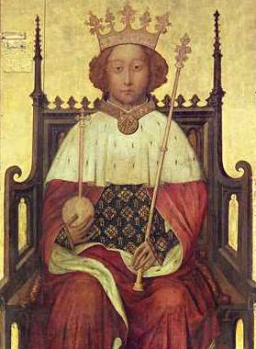
What do you need to be the perfect king or queen? Write a list of adjectives to describe the perfect monarch Explain what you thinks makes a great political leader and why Is Macbeth the perfect king? Why or why not?
Malcolm and Macduff

Slide 4
What makes for the perfect monarch?
Just (Knows right and wrong)
Verity (Truthful)
Temperate (Self-restrained)
Stable
Determined
Merciful
Devoted
Patient
Courageous
Macduff and Malcolm go on to discuss the key characteristics of a great king or queen, but generally the list on the left are the qualities most people in the Jacobean period would be looking for from their leader.
William Shakespeare wrote many ‘history’ plays that looked at key monarchs such as Richard II, Richard III, Henry V, Henry VIII and Henry IV parts 1 and 2. Whilst Henry V was described as being close to the perfect monarch, Richard III was the opposite or the antithesis of the perfect monarch.
Today we’ll look at how well Malcolm and Macbeth fit the role of a king.

Slide 5
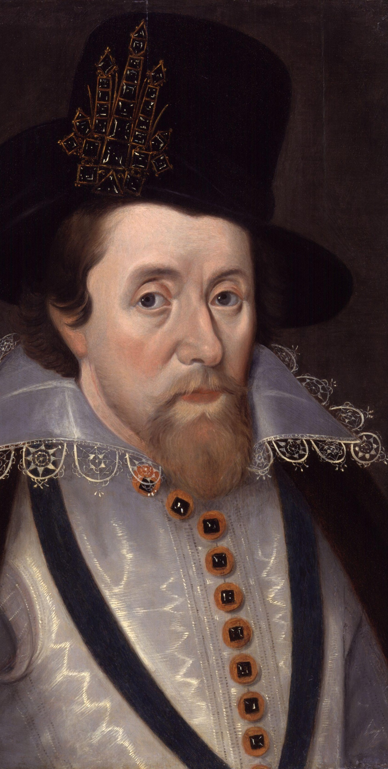
In the clip about Act 4 Scene 3 on the next slide, Macduff learns of the news of his slaughtered family
Watch how Malcolm behaves around Macduff.
What is your opinion about Malcolm?
How does Malcolm change Macduff’s perspective?
Is Malcolm the right man to be king based on this? Why? Why not?

Slide 7
MACDUFF Bleed, bleed, poor country! Great tyranny!
Macbeth’s tyranny and abuse of power has left everyone from the Scottish royal court suspicious, anxious and untrusting.
Both Malcolm and Macduff agree that Scotland is in a terrible state under Macbeth. They speak of the country ‘bleeding’, of sorrows and cries in the air and that Scotland is sinking.
Macduff goes to Malcolm to help him fight and destroy Macbeth and to rescue Scotland, but Malcolm is suspicious of Macduff. After all, Macbeth was once a good man and Macduff one of his favourites. How does Malcolm know Macduff won’t betray him to Macbeth to ‘appease an angry god’? Could Macduff get something from Macbeth for doing so?
MACDUFF
each new morn New widows howl, new orphans cry, new sorrows Strike heaven on the face, that it resounds As if it felt with Scotland and yell'd out Like syllable of dolour.
MALCOLM
I think our country sinks beneath the yoke; It weeps, it bleeds; and each new day a gash Is added to her wounds
MALCOLM
This tyrant, whose sole name blisters our tongues, Was once thought honest: you have loved him well. He hath not touch'd you yet. I am young; but something You may deserve of him through me, and wisdom To offer up a weak poor innocent lamb To appease an angry god.

Slide 8
Malcolm decides to test Macduff to see what kind of a subject he is
As we know, in this scene from Act 4 Scene 3, Malcolm decides to test Macduff’s morals and see how honest a person he is. Malcolm claims that if he were king, he would make Macbeth look “as pure as snow” in comparison.
It is not until the very end of his speech that Macduff admits that he could not allow such a monster to rule Scotland, even if Malcolm is the rightful heir to the throne.
Challenge: Focus on the highlighted sections. Translate each one.
Extra Challenge: Write a bullet point list of all the evils Malcolm says he would do as king.
Mega Challenge: What does Malcolm discover about Macduff? Has he passed the test? Why?
Super Challenge: Was Shakespeare trying to make a point about kingship here? What do you think it might be?

Slide 9
Malcolm reveals to Macduff that he was only testing him
In fact, this was apparently the first ever lie that Malcolm had ever spoken!
Malcolm seems to show a lot of the important qualities needed for a king.

Slide 10
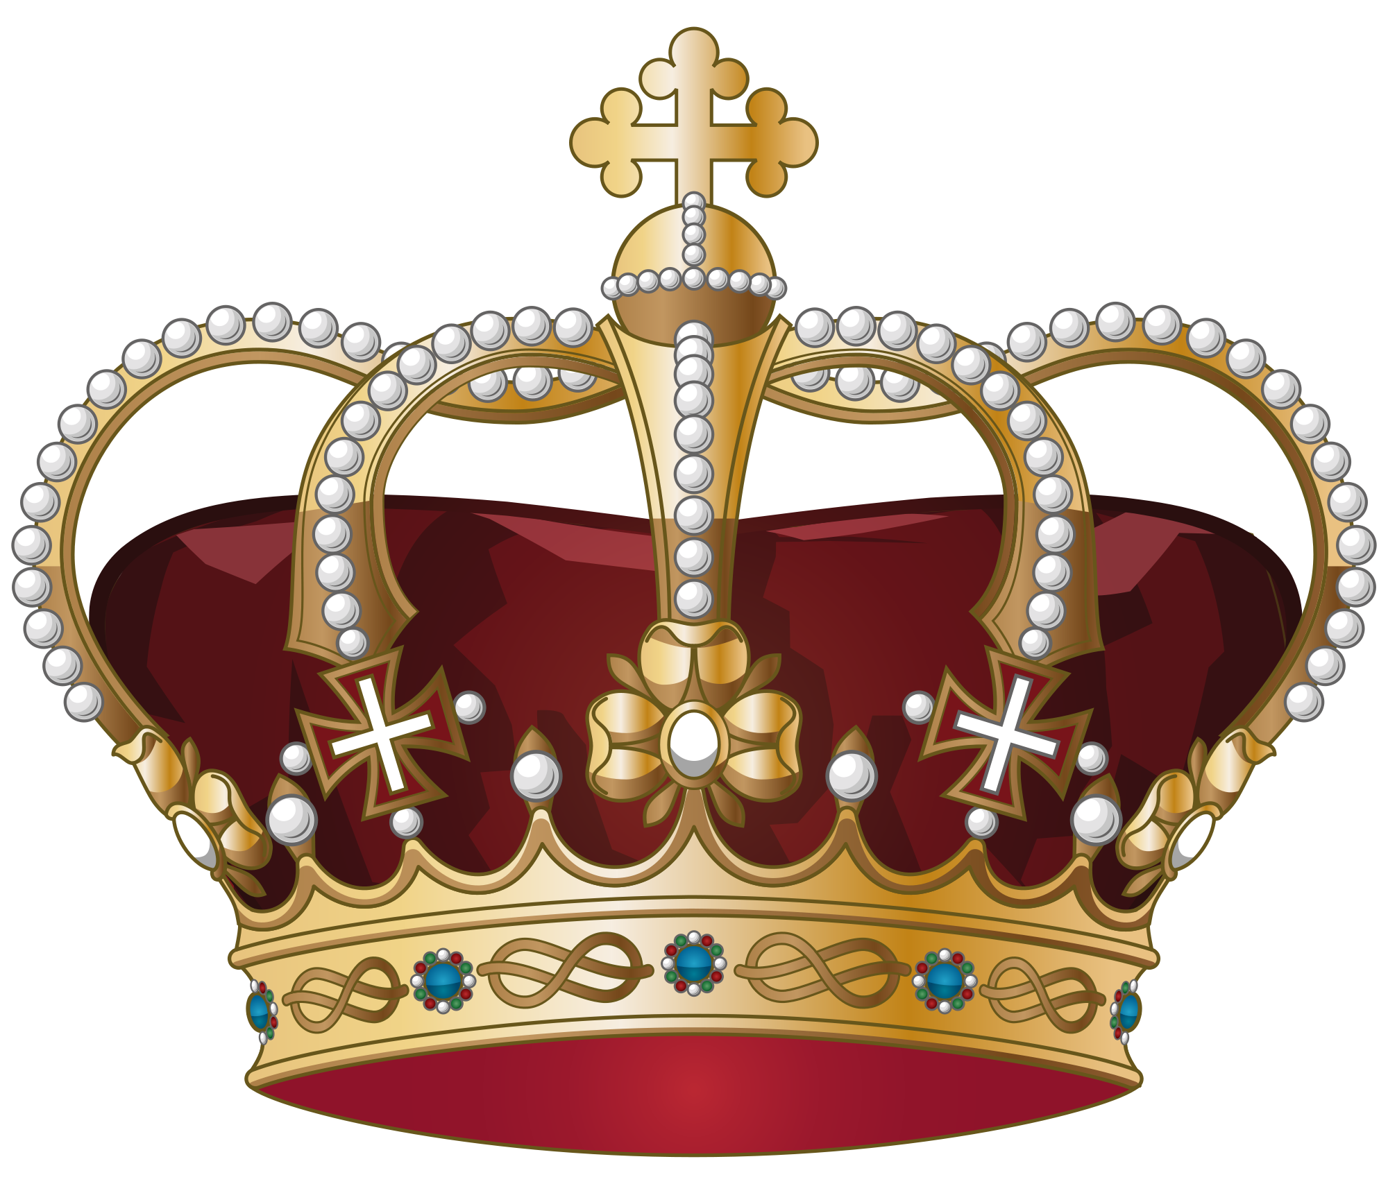
Now let’s see whom out of Macbeth and Malcolm is better suited to the role of king… We are going to watch an interview between Malcom and Macduff to see who we think would be better as king!
Kingly element | Macbeth | Malcolm
Just (Knows right and wrong)
Verity (Truthful)
Temperate (Self-restrained)
Stable
Determined
Merciful
Devoted
Patient
Courageous
Fill in your copy of the table
Extra Challenge: Who do you think is more suitable for the role of king?
Mega Challenge: Why was it important for Shakespeare to show this contrast between the two?

Slide 11
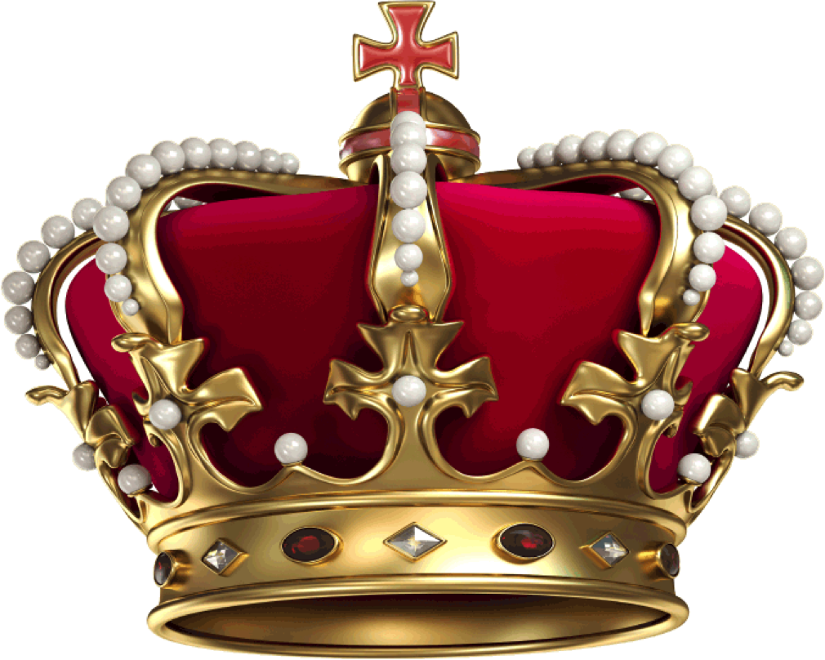
This link must be opened in the brower!
https://myshakespeare.com/macbeth/act-4-scene-3

Slide 12
We probably all agree that Malcolm is more suited to the role of king than Macbeth!
Kingly element | Macbeth | Malcolm
Just (Knows right and wrong)
Verity (Truthful)
Temperate (Self-restrained)
Stable
Determined
Merciful
Devoted
Patient
Courageous
We could argue Macbeth is determined (he is doing everything he can to stay in power) and courageous (he was once a brave warrior), but he is a liar, a traitor, a murderer, a tyrant and impatient.
In contrast, Malcolm seems to be honest, self-restrained, patient, determined, devoted and just. Now we will see how merciful and courageous he is in the rest of the play.

Slide 13
Plenary: Hot Seat!
You all have one minute to prepare questions to ask a student about what we have learnt today.
Next, one of you must come to the front and answer the questions.
To describe the key qualities of kingship and the type of character Malcolm is
To explain how Malcolm tests Macduff and why he does this
To evaluate who is the better suited for the role of king: Malcolm or Macbeth?

