Slide 1
Banquo and Macbeth
Banquo has seen both of the prophecies about Macbeth come true: He is both the Thane of Cawdor AND the King of Scotland.
On your mask in front of you draw or write on half the mask how Banquo feels
Make notes explaining your drawing
Evaluate why Shakespeare might want his audience to know how Banquo feels at this point in the play

Slide 2
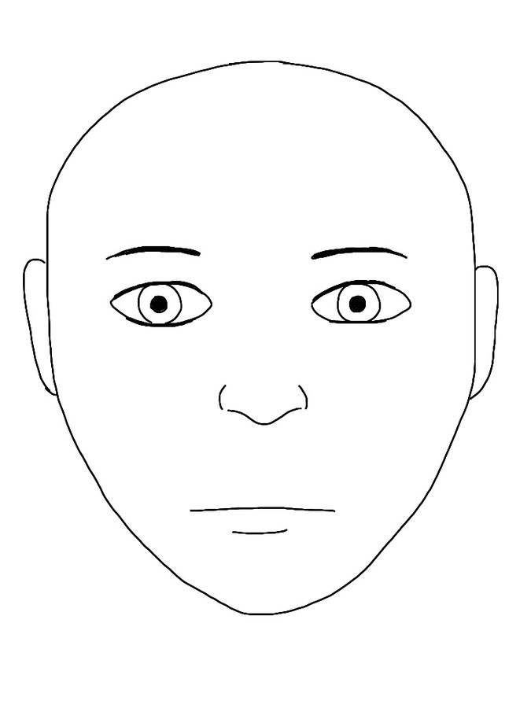
Banquo
Macbeth
Notes:
Alternatively, use actual blank masks that are available from most good stationers/art shops

Slide 3
Banquo is a noble warrior but also a good, moral individual
He thinks about what the witches told him, but he doesn’t act on what they said; he also tries to repress his thoughts about becoming the father to a line of kings.
However, he might feel some pangs of jealousy or envy, given Macbeth has now risen to be king. Moreover, he must suspect Macbeth of the murder of Duncan given what the witches said and that their prophecies have now come true.
Would Banquo feel anxious or excited? After all, the other predictions have come true already.

Slide 4
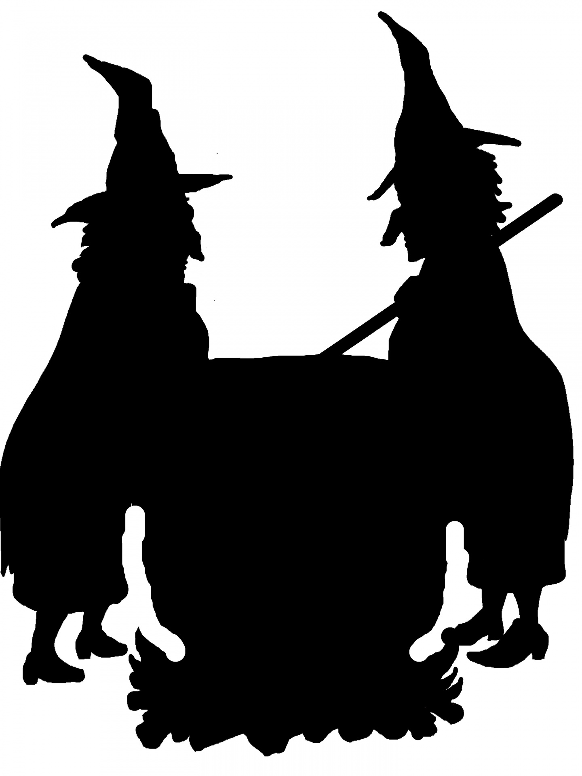
Learning outcomes
To describe the current emotions of Banquo and Macbeth in Act 3 Scene 1
To explain how Banquo’s emotions differ to Macbeth’s and why
To evaluate the portrayal of the characters in order to make predictions about the next part of the play

Slide 5
BANQUO Thou hast it now: king, Cawdor, Glamis, all, As the weird women promised, and, I fear, Thou play'dst most foully for't: yet it was said It should not stand in thy posterity, But that myself should be the root and father Of many kings. If there come truth from them-- As upon thee, Macbeth, their speeches shine-- Why, by the verities on thee made good, May they not be my oracles as well, And set me up in hope? But hush! no more.
Match up the pictures to key quotes in this extract. Use numbers, arrows or highlighters.
What does Banquo say? How does he feel?
How does Banquo’s attitude differ to Macbeth’s about ambition? Refer to key quotes.
https://www.youtube.com/watch?v=QOGdGaCmu9c
Notes:
http://maxpixel.freegreatpicture.com/Bloody-Smeared-Accident-Hand-Wound-Blood-Wounding-525988
By Vincent Le Moign, CC BY 4.0, https://commons.wikimedia.org/w/index.php?curid=68650652

Slide 6
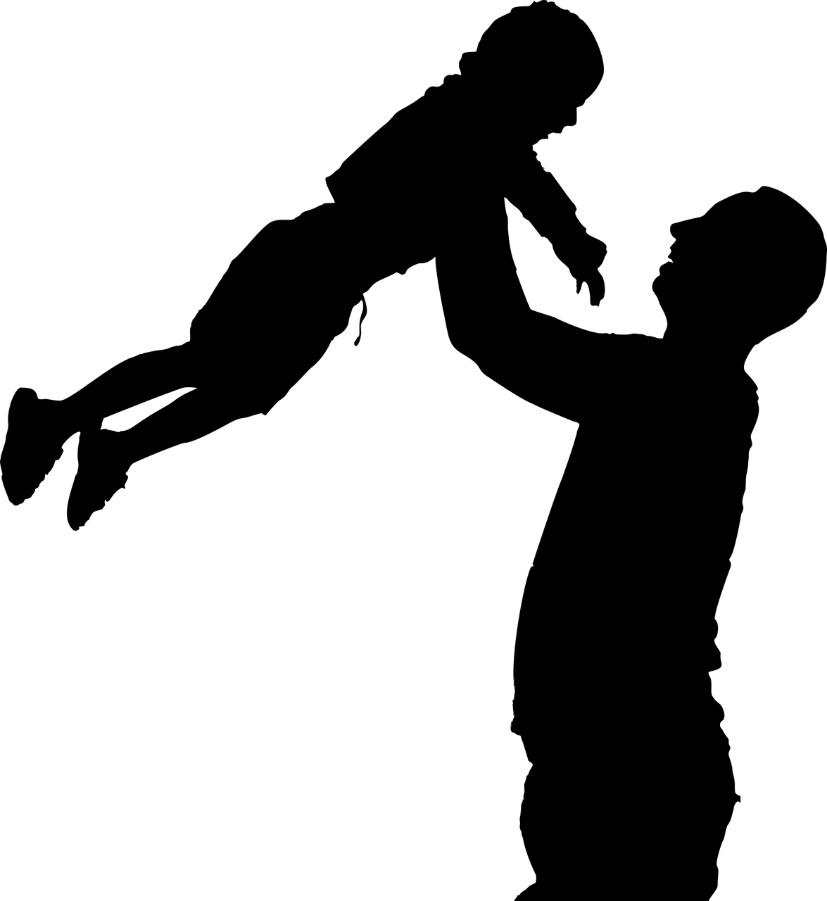
In this brief soliloquy (where a character speaks to themselves and allows the audience to know their innermost thoughts), Banquo reflects on Macbeth becoming Cawdor and King, just as the witches promised, but he thinks Macbeth most likely killed Duncan.
Banquo moves on to thinking about what the witches promised him, that he should be “the root and father / Of many kings.” If this were to come true it would be a wonderful thing for him, “their speeches shine”.
BANQUO Thou hast it now: king, Cawdor, Glamis, all, As the weird women promised, and, I fear, Thou play'dst most foully for't: yet it was said It should not stand in thy posterity, But that myself should be the root and father Of many kings. If there come truth from them-- As upon thee, Macbeth, their speeches shine-- Why, by the verities on thee made good, May they not be my oracles as well, And set me up in hope? But hush! no more.
He hopes this will happen and thinks it may do, but then stops himself as he hears others approach.

Slide 7
The very next scene sees Macbeth and Banquo meet for the first time since Duncan’s murder
We’ll watch the scene (Act 3 Scene 1): https://www.youtube.com/watch?v=C7u76nUpZt8
How is Macbeth feeling at the moment?
How do you know how he is feeling? What two quotes show us best?
Look at the images Shakespeare uses in his language when Macbeth is speaking (examples: fruitless crown). Why does he use these types of image?

Slide 8
To be thus is nothing; But to be safely thus.
Macbeth claims his current state means nothing, he needs to feel safe. However, with Banquo still around he can’t. He claims to fear him and the prophecy given to him by the witches.
Indeed, Macbeth says he fears no one except Banquo because he is the only one that can damage his genius or his ‘guiding spirit’.
Because Banquo’s children will be kings, Macbeth suggests this means he will have no children of his own, and therefore he has a ‘fruitless’ crown and a ‘barren’ sceptre, images associated with infertility and not being able to have children.
Our fears in Banquo Stick deep; and in his royalty of nature Reigns that which would be fear'd:
There is none but he Whose being I do fear: and, under him, My Genius is rebuked;
Upon my head they placed a fruitless crown, And put a barren sceptre in my gripe,

Slide 9
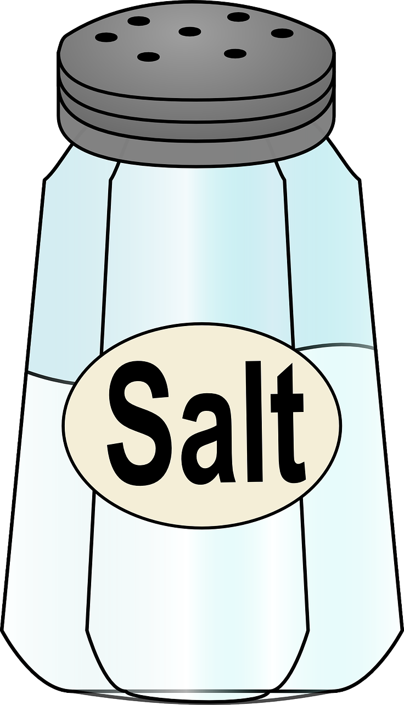
Thence to be wrench'd with an unlineal hand, No son of mine succeeding.
Macbeth uses the aggressive verb ‘wrench’d’ to suggest Banquo’s children will forcefully remove the crown from Macbeth and his ‘unlineal’ hand.
Macbeth reflects that he has ruined his peace of mind for Banquo’s children. When he talks of an ‘eternal jewel’, he alludes to his place in heaven – he has threatened this now just so Banquo’s kids can become kings.
Finally, he says he has killed the ‘gracious’ Duncan just to help out Banquo’s children.
Macbeth is bitter, angry and regretful.
Put rancours in the vessel of my peace Only for them; and mine eternal jewel Given to the common enemy of man, To make them kings, the seed of Banquo kings!
If 't be so, For Banquo's issue have I filed my mind; For them the gracious Duncan have I murder'd;

Slide 10
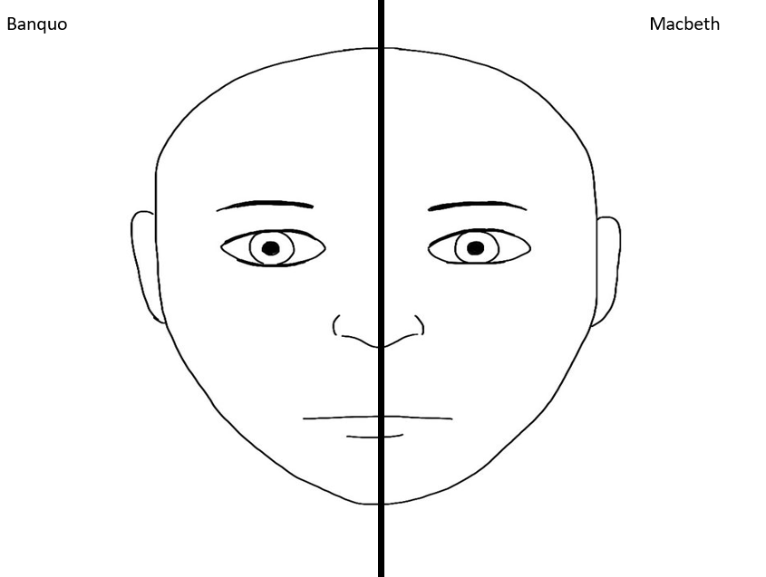
Now, go back to your ‘mask’ from the start of the lesson.
This time, use your notes from the lesson to draw how Macbeth is feeling at the moment.
Use the imagery from Macbeth’s speech as part of your drawing.
Is Macbeth right to be angry and resentful at Banquo and the prophecy foretold to him? Why?

Slide 11
Plenary: What Will Happen Next?
Using your post-it note, choose one of these options to show what you think will happen in the play next!
Macbeth will give up his throne to Banquo’s son
Macbeth will try to kill Banquo and Fleance his son
Macbeth will hire someone to kill Banquo and Fleance
Banquo and Macbeth will come to a deal about who should be king
Something else will happen
To describe the current emotions of Banquo and Macbeth in Act 3 Scene 1
To explain how Banquo’s emotions differ to Macbeth’s and why
To evaluate the portrayal of the characters in order to make predictions about the next part of the play

Slide 12
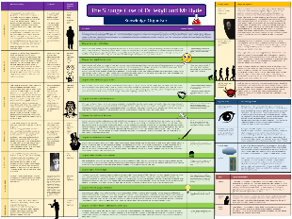
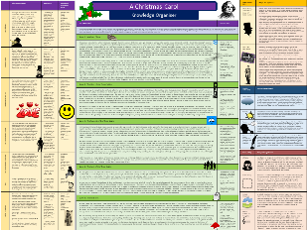
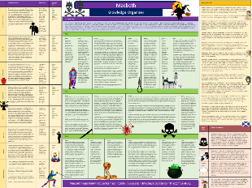
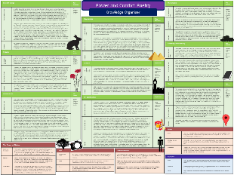
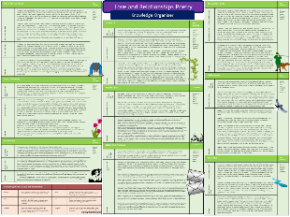
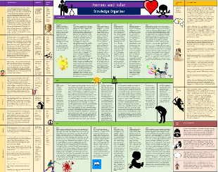
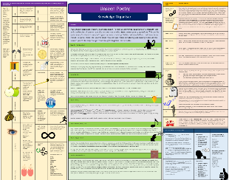
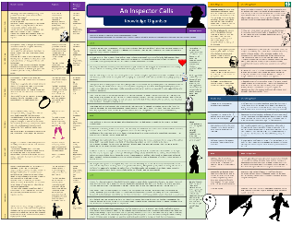
Want to revise English Literature?
Knowledge organisers, with everything in one place:
Jekyll and Hyde
A Christmas Carol
Macbeth
Power and Conflict Poetry
Love and Relationships Poetry
Romeo and Juliet
Unseen Poetry
An Inspector Calls
Literature exam practice packs with ANSWERS

Slide 13
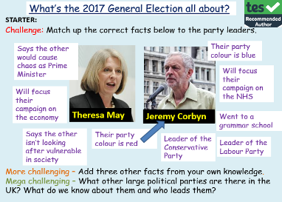
One of the most popular authors on TES!
Email:
info@englishgcse.co.uk
Website:
www.englishgcse.co.uk
This product, or any part of it, is not to be distributed, or resold under any circumstances, including through any websites, groups or organisations, without written permission from the author. Group and whole school licenses are available at the publisher’s request.
Thanks for choosing EC Resources
©EC Publishing Ltd August 19
©Lead Practitioner English August 19
Check out our website for offers and freebies. Right click here, follow the link.
English
PSHE
History
Citizenship
RE
Whole School
Follow us on twitter: @ec_publishing2 or facebook

