Slide 1
Spell It Out!
Can you solve these spooky anagrams of witches and wizards from literature?
Breedmould
Fanglad
Fazed Wiz Toh Or
Nimrel
Flakier Kenapasa
______________
__________
______ __________ ______ ______
__________
___________ ___________
For extra points, can you name the books they come from and their authors?

Slide 2
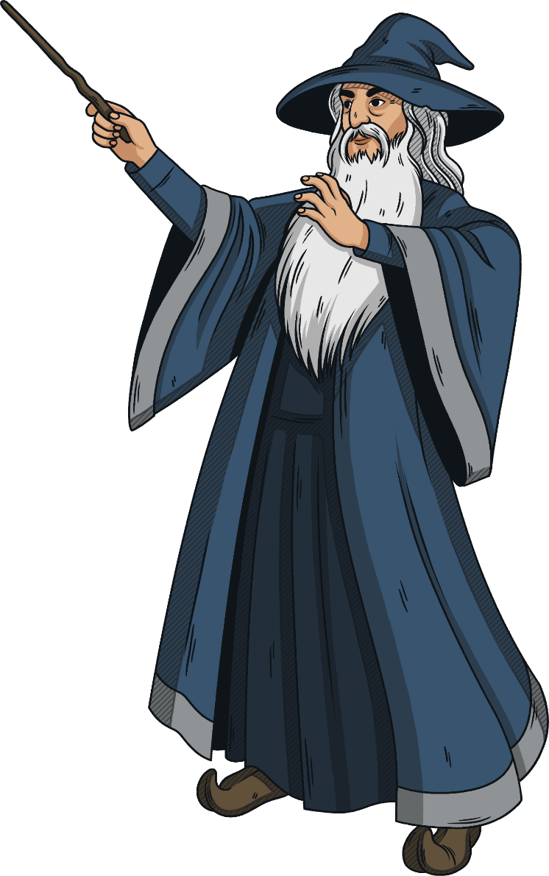
Spell It Out!
Breedmould
Fanglad
Fazed Wiz Toh Or
Nimrel
Flakier Kenapasa
Dumbledore from the Harry Potter books by J K Rowling.
Gandalf from The Lord of The Rings by J R R Tolkien.
The Wizard of Oz from The Wonderful Wizard Of Oz by L Frank Baum.
Merlin from Arthurian legends, including The Once and Future King by T H White.
Serafina Pekkala from His Dark Materials trilogy by Philip Pullman.

Slide 3
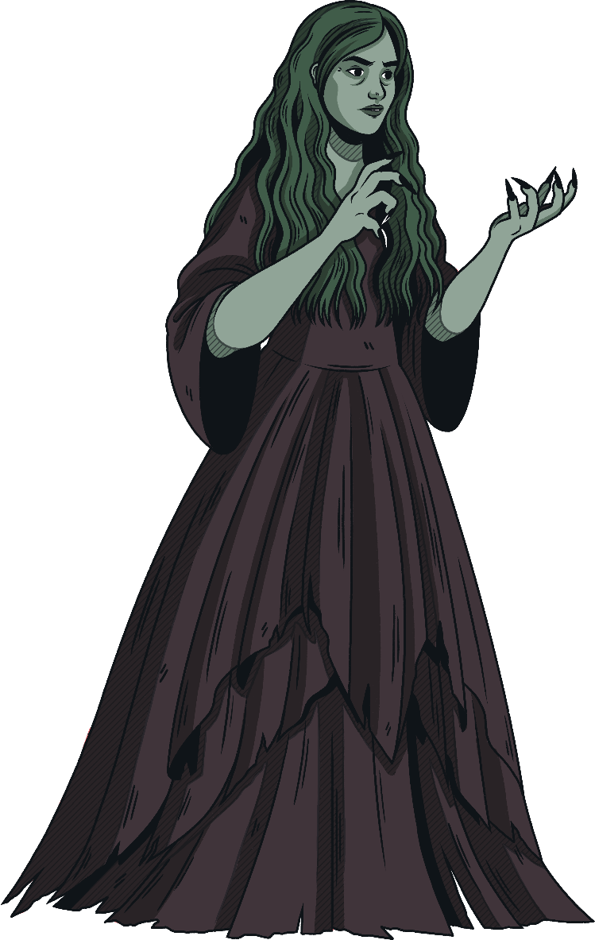
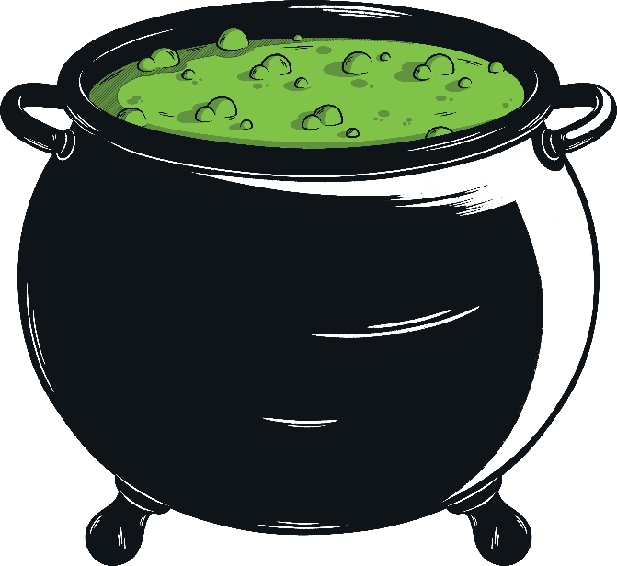
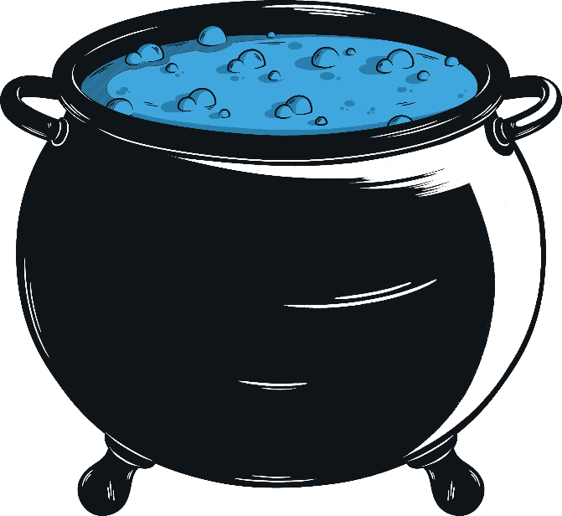
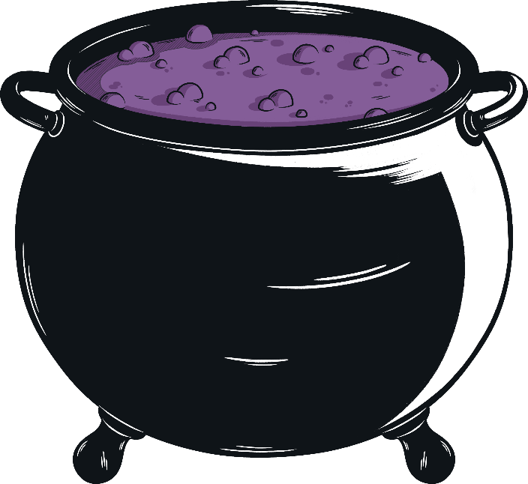
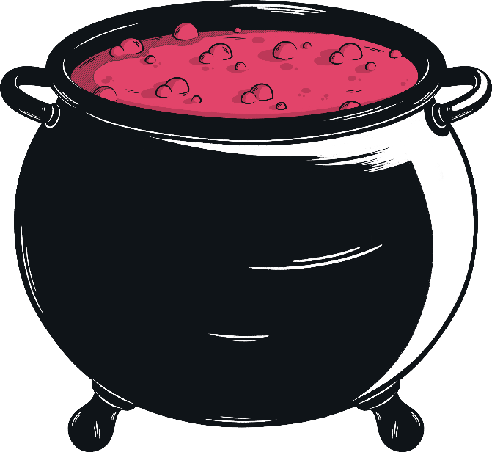
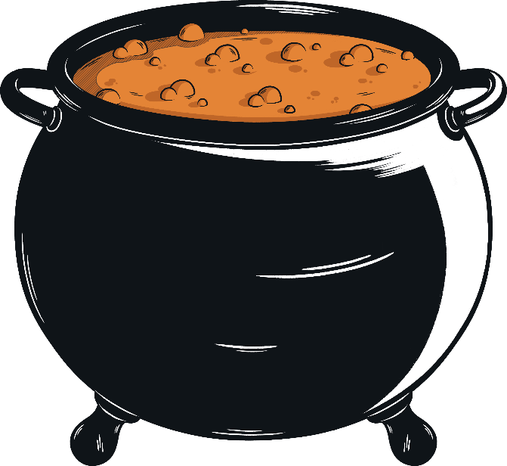
Double, double toil and trouble;
Fire burn and cauldron bubble.
Fillet of a fenny snake,
In the cauldron boil and bake;
Eye of newt and toe of frog,
Wool of bat and tongue of dog,
Adder's fork and blind-worm's sting,
Lizard's leg and howlet's wing,
For a charm of powerful trouble,
Like a hell-broth boil and bubble.
Double, double toil and trouble;
Fire burn and cauldron bubble.
Cool it with a baboon's blood,
Then the charm is firm and good.
Macbeth
What are the ingredients used in this potion?
Highlight them all.

Slide 4
Double, double toil and trouble;
Fire burn and cauldron bubble.
Fillet of a fenny snake,
In the cauldron boil and bake;
Eye of newt and toe of frog,
Wool of bat and tongue of dog,
Adder's fork and blind-worm's sting,
Lizard's leg and howlet's wing,
For a charm of powerful trouble,
Like a hell-broth boil and bubble.
Double, double toil and trouble;
Fire burn and cauldron bubble.
Cool it with a baboon's blood,
Then the charm is firm and good.
Macbeth
Now underline all the instructions which describe the method used in the spell.

Slide 5
Double, double toil and trouble;
Fire burn and cauldron bubble.
Fillet of a fenny snake,
In the cauldron boil and bake;
Eye of newt and toe of frog,
Wool of bat and tongue of dog,
Adder's fork and blind-worm's sting,
Lizard's leg and howlet's wing,
For a charm of powerful trouble,
Like a hell-broth boil and bubble.
Double, double toil and trouble;
Fire burn and cauldron bubble.
Cool it with a baboon's blood,
Then the charm is firm and good.
Macbeth
What do you notice about the highlighted words here?

Slide 6
Double, double toil and trouble;
Fire burn and cauldron bubble.
Fillet of a fenny snake,
In the cauldron boil and bake;
Eye of newt and toe of frog,
Wool of bat and tongue of dog,
Adder's fork and blind-worm's sting,
Lizard's leg and howlet's wing,
For a charm of powerful trouble,
Like a hell-broth boil and bubble.
Double, double toil and trouble;
Fire burn and cauldron bubble.
Cool it with a baboon's blood,
Then the charm is firm and good.
Macbeth
Which lines of this poem rhyme? Can you identify the rhyme scheme used?

Slide 7
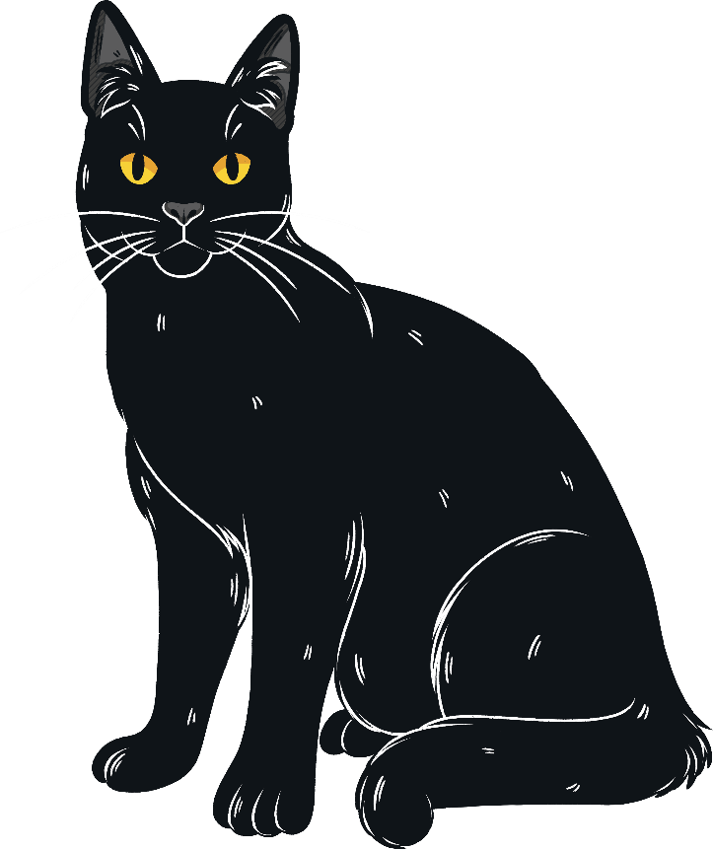
Successful Spells
You’re now going to try creating your own spell.
Firstly, we need to set our success criteria. What did we find out about the witches’ spell from Macbeth?
Success Criteria:
It uses a range of gruesome ingredients.
It describes a specific method.
It uses rhyming couplets.
It uses alliteration throughout.

Slide 8
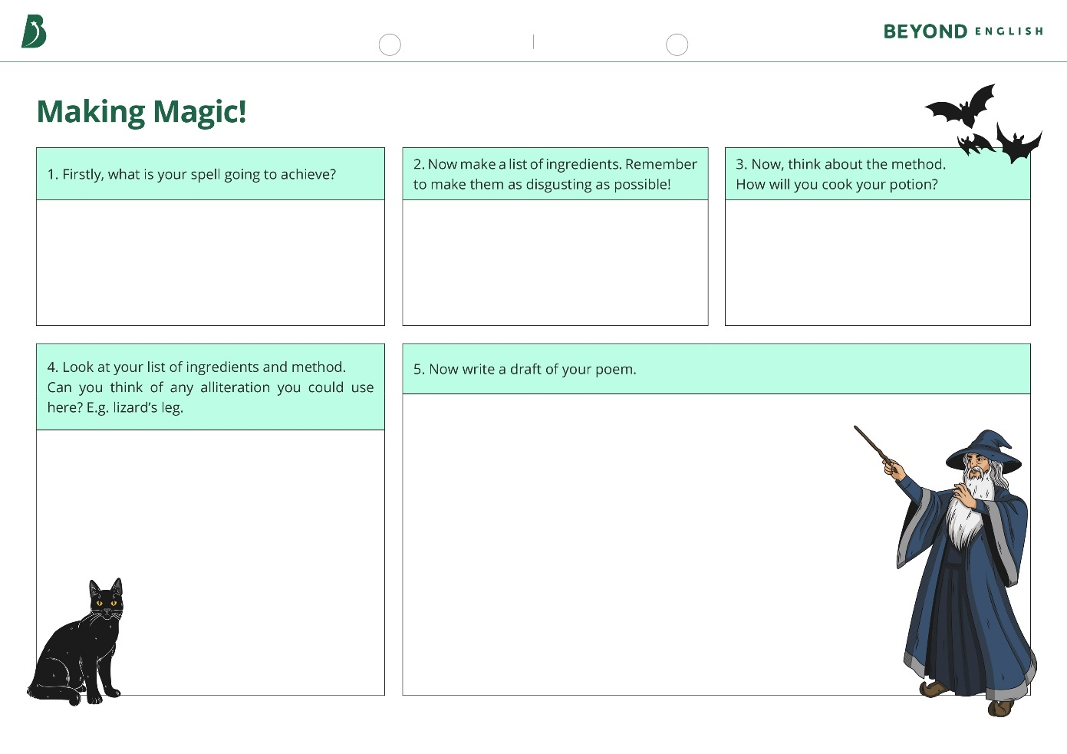
Making Magic
Now use the Making Magic sheet to create your perfect spell!
Success Criteria:
It uses a range of gruesome ingredients.
It describes a specific method.
It uses rhyming couplets.
It uses alliteration throughout.

Slide 9
Check Your Charms!
Swap your sheet with your partner.
Has your partner met the success criteria for the spell?
Success Criteria:
It uses a range of gruesome ingredients.
It describes a specific method.
It uses rhyming couplets.
It uses alliteration throughout.

Slide 10
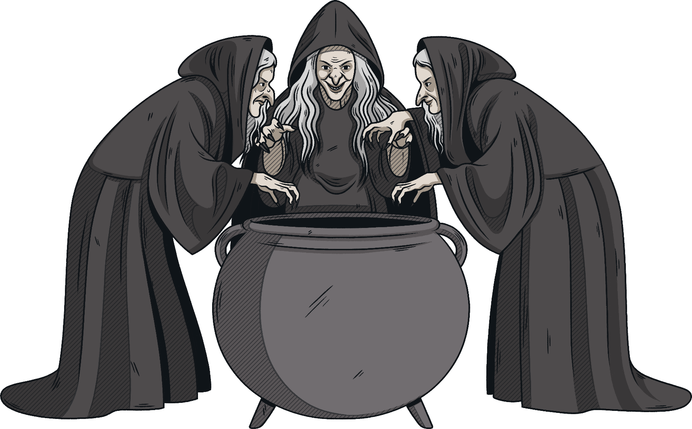
The Perfect Potion
Now copy up your spell onto the sheet provided. Remember to decorate it to make it look as spooky as possible!

