Slide 1
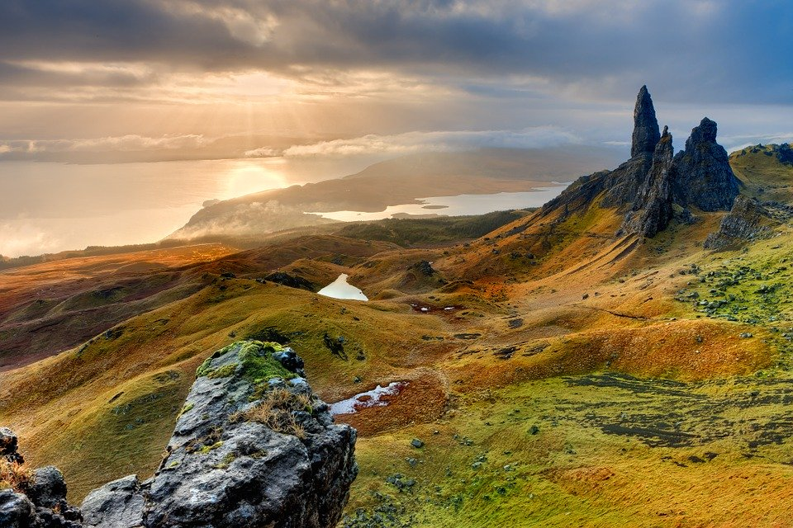
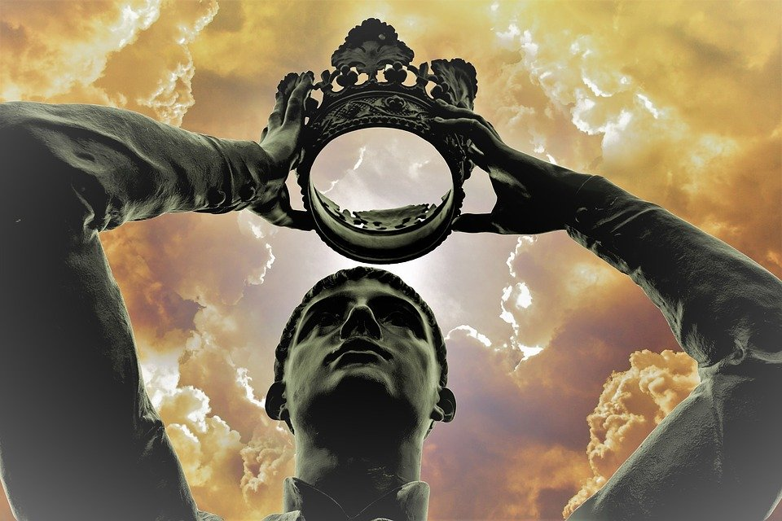
Macbeth Character Lesson
ALL: Be able to use a minimum of three adjectives to describe the character of Macbeth and be able to explain why these are applicable.
MOST: To understand how the character of Macbeth changes throughout the play.
SOME: To be able to link your ideas to your understanding of context.

Slide 2
Starter Task
Match these Shakespearian terms to their correct definition.
Term | Definition
Hell- kite | Someone who avoids giving a clear answer
Aweary | Do
Hither | From now on
Knell | Messengers
equivocator | Towards
Anon | A fierce fighter
Dost | Mentally or physically fatigued
Hence | The sound of a funeral bell
Missives | Soon
You have three minutes!

Slide 3
Starter Task
Answers:
Term | Definition
Anon | Soon
Dost | Do
Hence | From now on
Hither | Towards
equivocator | Someone who avoids giving a clear answer
Hell- kite | A fierce fighter
Aweary | Mentally or physically fatigued
Knell | The sound of a funeral bell
Missives | Messengers

Slide 4
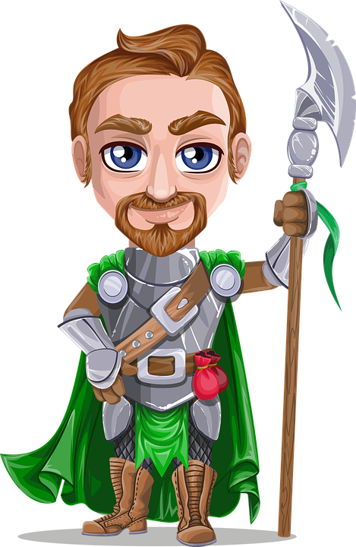
Task
For brave Macbeth--well he deserves that name-- Disdaining fortune, with his brandish'd steel, Which smoked with bloody execution, Like valour's minion carved out his passage Till he faced the slave; Which ne'er shook hands, nor bade farewell to him, Till he unseam'd him from the nave to the chaps, And fix'd his head upon our battlements
Read this description of Macbeth from Act 1 Scene 2. Make a list of five adjectives that you think best describe our first impressions of Macbeth from this extract.

Slide 5
Task
You Could Have Had:
Brave
Brutal
Heroic
Bold
Daring
Fearless
Valliant
Courageous
Ruthless
Fierce
Violent
Unafraid
Loyal
Admired
You should now write one PEA paragraph answering the following question:
In what way does Shakespeare gives us a positive impression of Macbeth at the beginning of the play?
You should:
Include a minimum of one quotations to support your point.
Discuss what effect this could have had upon the audience.
Analyse Shakespeare's use of language.
P (point) – Make a point using a simple sentence.
E (Evidence) – Support your point using evidence (a quotation from the extract)
A (Analyse) – Explain your point by analysing the use of words/ language devices and their purpose. Your analyse section of your paragraph should be a minimum of four sentences long.
CHALLENGE: Can you link your explanation to the play as a whole?

Slide 6
Example answer
At the beginning of the play Macbeth is presented as a valiant and decisive soldier. We are told that “Which ne'er shook hands, nor bade farewell to him”, meaning that Macbeth killed Macdonwald swiftly and without hesitation. This description gives the audience a positive impression of Macbeth who has bravely fought against the enemies of Scotland and courageously risked his life for his King. We are also told that Macbeth “carved out his passage”, showing that he brutally cut down any enemy who blocked his path to the traitor. This determination suggests that he was resolute in his plan to kill the traitor who betrayed King Duncan.
Conversely, we later see a contrasting side of Macbeth, who far from being decisive and a source of vengeance, allows himself to be manipulated and controlled by his wife into becoming a traitor himself.
Look at the example answer above. Can you use this example to improve your own response?

Slide 7
task
“Stars, hide your fires;
Let not light see my black and deep desires”
“We will proceed no further in this business:
He hath honour'd me of late”
“Will all great Neptune's ocean wash this blood
Clean from my hand?”
“O, full of scorpions is my mind, dear wife!”
“We have scotch'd the snake, not kill'd it:”
“And be these juggling fiends no more believed,
That palter with us in a double sense”
Take a look at the key quotations in the box to the left. For each quotation, create a spider diagram analysing the following:
How is Macbeth feeling / presented.
Any key words / their meanings and connotations.
What language devices are used are why.
What is the effect on the audience.
Links to themes.
Analysis of structure (punctuation etc).
Links to plot (the play as a whole).
Links to context (Jacobean England).
CHALLENGE:
For each of your spider diagrams, create an image that you believe represents each key quotation.

Slide 8
task
Using your spider diagrams, copy and complete the following table.
Quotation | Meaning | Analysis | Challenge: CONTEXT
“Stars, hide your fires; let not light see my black and deep desires”
“We will proceed no further in this business: he hath honour'd me of late”
“Will all great Neptune's ocean wash this blood clean from my hand?”
“O, full of scorpions is my mind, dear wife!”
“We have scotch'd the snake, not kill'd it”
“And be these juggling fiends no more believed, that palter with us in a double sense”

Slide 9
EXAMPLE
Quotation | Meaning | Analysis | Challenge: CONTEXT
“Stars, hide your fires; let not light see my black and deep desires” | This means that Macbeth wishes for it do be dark so that he is able to hide his growing ambitions. | This use of personification demonstrates Macbeth’s “secret desires”, namely his ambition to become king himself following his meeting with the three Witches. However, he wishes the stars to “hide” their “fires”, showing us that he wishes to hide his true thoughts from those around him. This directly links to the theme of duplicity and highlights Macbeth’s devious nature. Macbeth is clearly torn between his sense of right and wrong. The reference of light and dark (the “fire” in contrast to the “black” desires) is representative of the themes of good and evil. | In Jacobean England it was a commonly held belief that God was unable to see your misdeeds in the dark and so they could go unpunished in the eyes of the lord. Macbeth’s words echo his belief, as he homes that the “light” (God) will be unable to punish him for his “black” (evil) thoughts.
Swap your grids with another student. You should now add anything to their grid that you feel that they could have included and highlight any errors. When you are finished, swap back and review the comments you have been given.

