Slide 1
Key adjectives:
Initially:
Courageous, valiant
Appears to be loyal, patriotic, noble
Develops into a character that is:
Ambitious
Deceptive, false
Ruthless, callous, tyrannical
Ultimately:
World weary
Philosophical
Brave (a constant trait)
defiant
Under each heading add at least 3 words/phrases you would use to describe the character of Macbeth.
Share and feedback.
What aspects of the following clip are analytical?
http://www.youtube.com/watch?v=N7HYSrADXv8

Slide 2
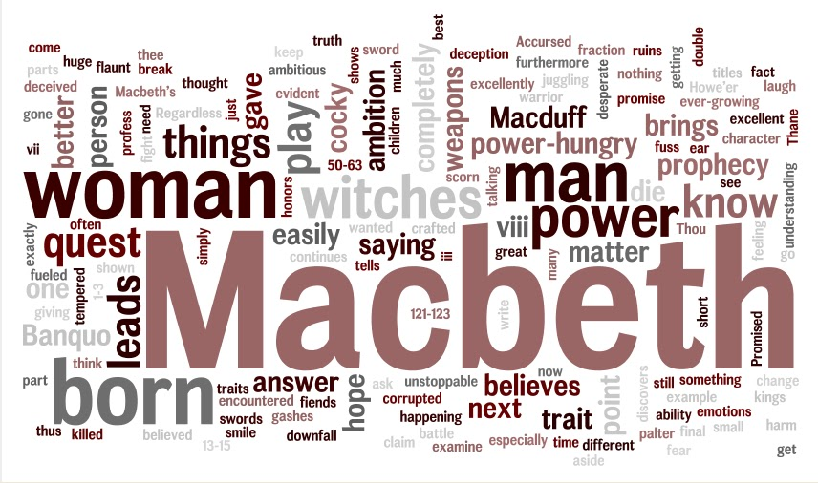
Using the wordle, create 5 sentences introducing the character‘Macbeth’ to the class.

Slide 3
Pair work: Find quotes to support these key points
When we first meet Macbeth – a brave war hero – saviour of Scotland
But ominous details of Macbeth carving through his enemies suggest his capacity for violence
Macbeth’s dark desires to be king are revealed in his reaction to the witches prophecy

Slide 4
Think/Pair/Share How do you feel about Macbeth at this point?
Terror and indecisiveness at evil deeds planned – shows humanity Lady Macbeth wants to rid him of – we sympathise with Macbeth at this stage – vacillates, hesitates.
“Present fears/are less than horrible imaginings.” Then decides upon regicide.
Wishes he could skip the consequences of murder – will be haunted by his deeds from now on – he instinctively know that his evil will not be “the be-all and……” (1.7)

Slide 5
My opinion of Macbeth
Now that’s analysing!
An evil tyrant/fiend/demon/ “hell-hound”/ devilish “butcher”/ “accursed beast by the end
BUT we still pity him because he was never inherently evil
INSTEAD, he was a man too easily swayed by others and led astray by his own flaws of greed and ambition

Slide 6
Hamartia (tragic flaw) of ambition
The idea that he will have an heirless future with only a “fruitless crown” and “barren sceptre fills him with
_(add 2 adjectives to describe his feelings)___.
How does Macbeth ensure the throne is secure? Add your reaction to this action.

Slide 7
Sample paragraph
What’s missing here?
As the play progresses, Macbeth descends further and further into evil. He takes the Witches’ misleading prophecies as gospel and decides to murder his life long friend and comrade Banquo to ensure his throne is secure. This decision makes us lose any respect or sympathy for Macbeth as he puts his greed for power above morality without any remorse or hesitancy. Furthermore, Macbeth recklessly decides to act on impulse from this point on in the play. He slaughters Macduff’s entire family as punishment when his enemy flees Scotland. The murders of an innocent woman and her children are little more than meaningless acts of violence. I think it is revealing that Macbeth’s previous murders always had some logic (however disturbed) behind them, whereas now he murders only for evil’s sake.

Slide 8
Top Ten Qs
Valiant soldier or violent schemer at the beginning?
Which factor is most influential: (a) Witches & their prophesy? (b) Vaulting ambition? (c) Lady Macbeth?
Immediate & overpowering remorse – what’s that about?
Why is he obsessed with killing Banquo? (oh yeah, and Fleance too)
Has he completely lost it in the Banquet scene? (do you think the Ghost is real or imaginary?)
How does he justify his decision to proceed down the path of evil?
He visits the Witches for a second time. Why? How does he react?
Explain his decision to murder Lady Macduff & children (increasingly erratic & illogical behaviour)
What last vestiges of humanity, conscience, nobility, bravery do we see?
Is he nothing more than a “dead butcher” or do we the audience feel differently about him at the end?
Notes:
To really get to grips with Macbeth’s character you must form your own personal opinions. Use these 10 questions to get to grips with how YOU feel about his personality. Remember there is no RIGHT interpretation there are only opinions backed up with quotes / examples.

Slide 9
Additional notes
These suggested points are some of your options
Select 5-8 of them and develop each point into a 5-10 line paragraph
These paragraphs will form the basis of your essay
Don’t forget your quotations to prove your points!

Slide 10
Imagery
Disease
Damnation
Hell
The Devil
Weeds
Poison
Evil
Supernatural

Slide 11
Macbeth = positive (1st impression)
At the start of the play = highly respected figure
He has effectively saved Duncan’s kingship, putting down a rebellion within Scotland and repelled an attack by the King of Norway who attempted to take advantage of the confusion in Scotland.
Macbeth is portrayed as a fierce warrior who cuts a bloody swathe through the ranks of his enemies
His ferocity is such that he almost splits the rebel Macdonwald in two.
He is described in admiring tones.
Macbeth is held in high regard by Duncan who plans to reward his loyal subject with the title of Thane of Cawdor following the treachery of the previous holder of this prestigious title.

Slide 12
Macbeth’s flaw = leads him into evil
Flawed nature
“Vaulting ambition”
Flaw – hidden in his heart at first
Witches have uncovered his flaw
This is reason they targeted him
Urgent desperation betrays his hidden ambition
“black” greed concealed within
Before he kills Duncan, his better nature or conscience struggles against his flaw
Shows he has some humanity left
Tells his wife he cannot go ahead with the crime
After regicide – regrets letting his flaw overpower his humanity.
Torn apart by guilt and instant remorse

Slide 13
Achievement of ambition = no sense of contentment
Feelings of insecurity from this point on, never again enjoying any sense of inner peace.
Banquo is seen as a threat because of his essential nobility (‘royalty of nature’) and because of the prophecy that he would be father to a line of kings.
Macbeth’s mind is ‘full of scorpions’ and he even envies Duncan the tranquil sleep of death.

Slide 14
Punishment for his flaw (find quotes to support)
He hears voices damning him to eternal sleeplessness
He can’t pray
The blood on his hands is an inescapable symbol of guilt
His guilt takes form in Banquo’s ghost
Fears madness and social ruin
Screams hysterically
Ultimate punishment: Macbeth realises it has all been for nothing
He has lost everything he once valued because of his flaw and the weakness in his character
He has lost his honour, respect, loyal supporters, his wife, hope of heaven, his peace of mind, etc.

Slide 15
Sample Conclusion
To conclude, in many ways Macbeth is defined by his hamartia of “vaulting ambition.” Despite the external forces of evil at work against him, it is ultimately Macbeth’s own flawed nature which causes his downfall. It is Macbeth’s flaw which changes him from a “worthy gentleman” to a “dead butcher” so, in the end, he only has himself to blame for his miserable fate. This, perhaps, is the worst punishment of all.

