Slide 1
Act 1 Scene 5
Lady ______ reads a letter from her husband telling her about the Witches’ ______. She begins to ______ King Duncan’s ______. Macbeth arrives and they ______ to kill Duncan that _______.
decide plot evening prophecies Macbeth murder

Slide 2
Act 1 Scene 5
Manipulative
Ambitious
Calculating
Powerful
Having or showing a strong desire and determination to succeed.
Skilfully influencing a person or situation
Acting in a devious and ruthlessly determined way
Having a strong effect on people’s thoughts and feelings

Slide 3
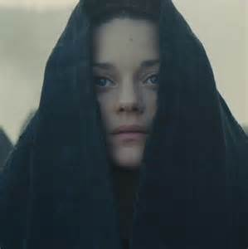
Act 1, scene 5: The introduction of Lady Macbeth
Consider what you know about Jacobean society. How would the typical woman be expected to act?
What kind of woman would marry Macbeth, knowing what you know about him?

Slide 4
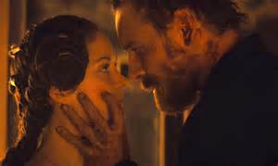
What happens???
Lady Macbeth reads a letter from her husband telling her about the Witches’ prophesies. She fears that Macbeth lacks the ruthlessness he needs to kill Duncan and fulfill the witches second prophecy. When she learns that King Duncan is coming to visit, she calls upon supernatural agents to fill her with cruelty. Macbeth arrives, and Lady Macbeth tells him that she will take charge of the preparations for Duncan’s visit and for his murder.

Slide 5
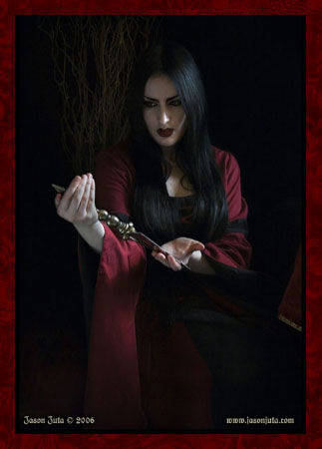
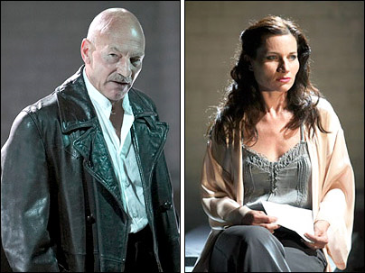
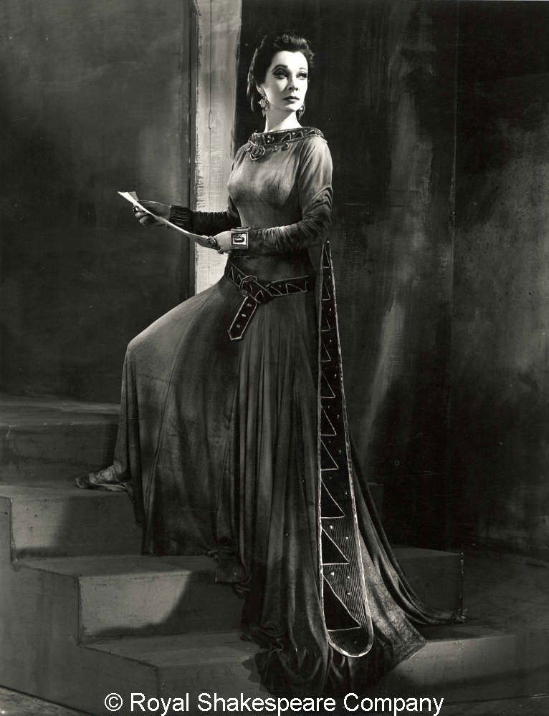
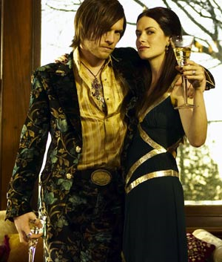
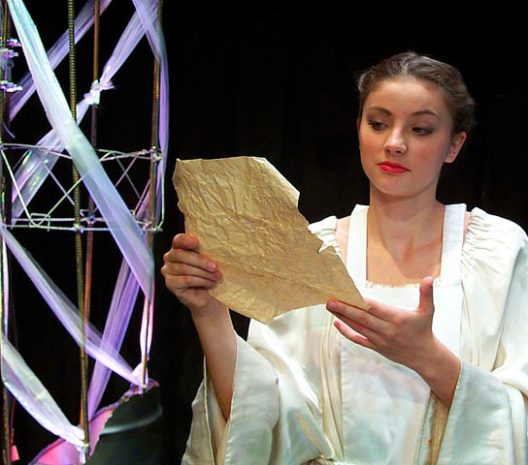
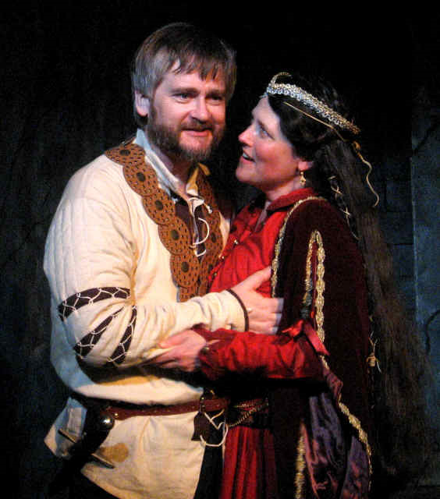
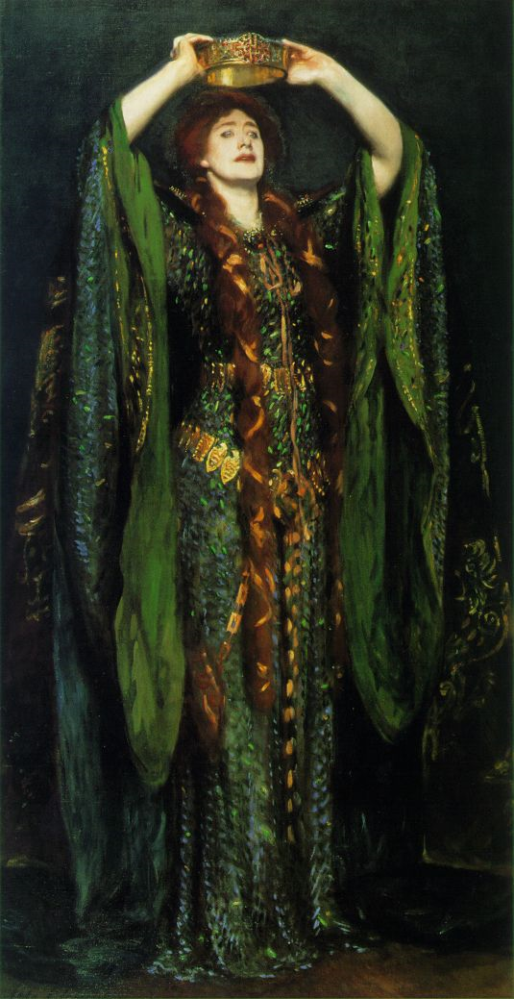

Slide 6
Lines 10-29
You are thane of Glamis and Cawdor, and you’re going to be king, just like you were promised. But I worry about whether or not you have what it takes to seize the crown. You are too full of the milk of human kindness to strike aggressively at your first opportunity. You want to be powerful, and you don’t lack ambition, but you don’t have the mean streak that these things call for. The things you want to do, you want to do like a good man. You don’t want to cheat, yet you want what doesn’t belong to you. There’s something you want, but you’re afraid to do what you need to do to get it. You want it to be done for you. Hurry home so I can persuade you and talk you out of whatever’s keeping you from going after the crown. After all, fate and witchcraft both seem to want you to be king.

Slide 7
Lines 37-53
So the messenger is short of breath, like a hoarse raven, as he announces Duncan’s entrance into my fortress, where he will die. Come, you spirits that assist murderous thoughts, make me less like a woman and more like a man, and fill me from head to toe with deadly cruelty! Thicken my blood and clog up my veins so I won’t feel remorse, so that no human compassion can stop my evil plan or prevent me from accomplishing it! Come to my female breast and turn my mother’s milk into poisonous acid, you murdering demons, wherever you hide, invisible and waiting to do evil! Come, thick night, and cover the world in the darkest smoke of hell, so that my sharp knife can’t see the wound it cuts open, and so heaven can’t peep through the darkness and cry, “No! Stop!”

Slide 9
Read Lady Macbeth’s soliloquy and highlight any words that associate her with evil.
The raven himself is hoarse
That croaks the fatal entrance of Duncan
Under my battlements. Come, you spirits
That tend on mortal thoughts, unsex me here,
And fill me from the crown to the toe top-full
Of direst cruelty! make thick my blood;
Stop up the access and passage to remorse,
That no compunctious visitings of nature
Shake my fell purpose, nor keep peace between
The effect and it! Come to my woman’s breasts,
And take my milk for gall, you murdering ministers,
Wherever in your sightless substances
You wait on nature’s mischief! Come, thick night,
And pall thee in the dunnest smoke of hell,
That my keen knife see not the wound it makes,
Nor heaven peep through the blanket of the dark,
To cry ‘Hold, hold!’

Slide 10
Read Lady Macbeth’s soliloquy and highlight any words that associate her with evil.
The raven himself is hoarse
That croaks the fatal entrance of Duncan
Under my battlements. Come, you spirits
That tend on mortal thoughts, unsex me here,
And fill me from the crown to the toe top-full
Of direst cruelty! make thick my blood;
Stop up the access and passage to remorse,
That no compunctious visitings of nature
Shake my fell purpose, nor keep peace between
The effect and it! Come to my woman’s breasts,
And take my milk for gall, you murdering ministers,
Wherever in your sightless substances
You wait on nature’s mischief! Come, thick night,
And pall thee in the dunnest smoke of hell,
That my keen knife see not the wound it makes,
Nor heaven peep through the blanket of the dark,
To cry ‘Hold, hold!’
Raven
Fatal
Hell
Spirits
Blood
Cruelty
Unsex (Christian mind-set)
Knife
Murdering
Mischief
Gall
Fell
Pall

Slide 11
Symbolism
Shakespeare uses several language techniques to set Lady Macbeth apart from the other characters. One of these techniques is symbolism: the raven symbolises death and evil, and could be seen as a witch’s familiar. The raven crying itself “hoarse” suggests the death of King Duncan. Also, blood is used as a symbol of Lady Macbeth’s strength and power: “make thick my blood”. This shows that Lady Macbeth is powerful enough to manipulate Macbeth into killing Duncan. This would shock a Jacobean audience because women were expected to be gentle and nurturing.

Slide 12
Personification
Another technique Shakespeare uses is personification: “nature’s mischief”. This gives the human quality of evil to nature to make it seem more powerful and threatening. Similarly, “heaven peep” makes heaven seem like a person which could suggest that heaven represents God or Lady Macbeth’s conscience. This use of personification further affects the audience who would be disgusted by her lack of obedience to God and her admiration of the witches’ power.

Slide 13
How is Lady Macbeth presented as a powerful woman in the extract?
In pairs, find the following:
Repetition
Symbolism
Personification
Alliteration
Commands

Slide 14
Repetition, symbolism, personification, alliteration and commands
The raven himself is hoarse
That croaks the fatal entrance of Duncan
Under my battlements. Come, you spirits
That tend on mortal thoughts, unsex me here,
And fill me from the crown to the toe top-full
Of direst cruelty! make thick my blood;
Stop up the access and passage to remorse,
That no compunctious visitings of nature
Shake my fell purpose, nor keep peace between
The effect and it! Come to my woman’s breasts,
And take my milk for gall, you murdering ministers,
Wherever in your sightless substances
You wait on nature’s mischief! Come, thick night,
And pall thee in the dunnest smoke of hell,
That my keen knife see not the wound it makes,
Nor heaven peep through the blanket of the dark,
To cry ‘Hold, hold!’

Slide 15
Act 1 Scene 5
What’s the significance of the line “as he purposes”?
How does LM answer in the next 2 lines? How is her speech different to Macbeth’s?
What advice does she give?
What does the metaphor suggest?
Who speaks more?
What’s LM’s final line, and what does this suggest to the audience?

