Slide 1
Macbeth
Act 1 Scene 1
Prologue: The Witches

Slide 2
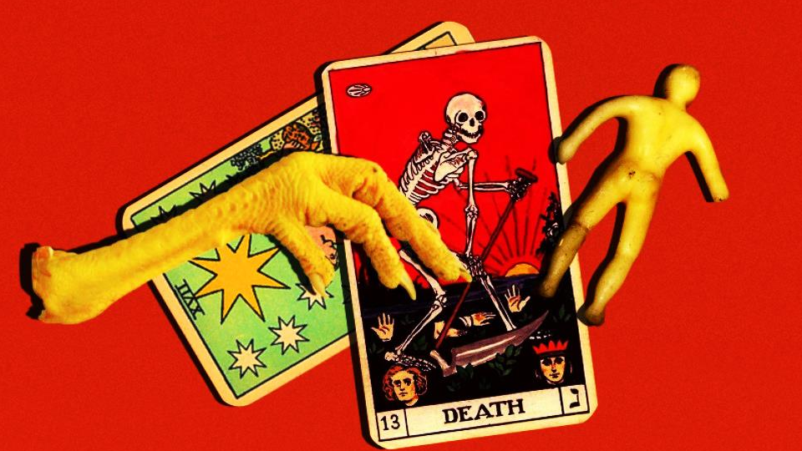
Lesson Objectives

Slide 3
Lesson Objectives
By the end of this lesson we will have read and analysed Act 1, Scenes 1 and 2.
We will think about the context of Shakespeare’s era.
We will also make predictions about plot.
We will discuss why Shakespeare has included specific elements.

Slide 4
A note on reading Shakespeare
If you look beside the words in the script, you should notice small numbers that increase by 5. These are line numbers.
Numbering the lines allows us to easily discuss specific parts of the play, and it is important that you keep track of the line numbers during discussions.
Similarly, rather than Chapters, plays have Acts and Scenes.
Therefore, when we read plays, we do not refer to page numbers, but to the Act, Scene and line number.

Slide 5
A note on reading Shakespeare
The language that Shakespeare wrote in is a little different from how we speak today – he wrote in Early Modern English. Some words and pronunciation have changed since then.
Speaking the words aloud allows you to better understand what is being said.
Plus it is more fun to do some acting!
Everyone is in the same boat – it’s hard, but rewarding!

Slide 6
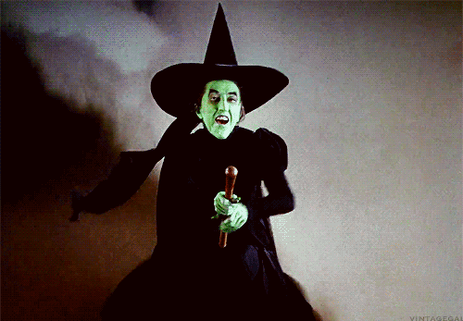
Casting the Parts!
When we read scenes from the play, it works better if we have different volunteers from the class read the parts.
For this scene (it is very short!), I need three volunteers to read:
First Witch
Second Witch
Third Witch

Slide 7
SCENE I. A deserted place.
Thunder and lightning. Enter three Witches
First Witch
When shall we three meet again
In thunder, lightning, or in rain?
Second Witch
When the hurlyburly's done,
When the battle's lost and won.
Third Witch
That will be ere the set of sun.
First Witch
Where the place?
Second Witch
Upon the heath.
Third Witch
There to meet with Macbeth.
First Witch
I come, Graymalkin!
Second Witch
Paddock calls.
Third Witch
Anon.
ALL
Fair is foul, and foul is fair:
Hover through the fog and filthy air.
Exeunt

Slide 8
SCENE I. A deserted place.
Everyday Language Translation
Thunder and lightning. Enter three Witches
First Witch
When will we meet next time,
When there’s thunder, lightning, or rain?
Second Witch
When the confusion is over,
When the battle is over and the winner is clear.
Third Witch
That will happen before sunset.
First Witch
Where will me meet next time?
Second Witch
On a hill.
Third Witch
That is where we’ll meet Macbeth.
First Witch (responding to a noise)
I’m coming, my grey cat!
Second Witch
My toad is calling for me.
Third Witch
Soon we’ll meet.
ALL together
Fair is foul, and foul is fair:
Let’s fly through the fog and filthy air.
Exeunt – everyone leaves at the same time.

Slide 9
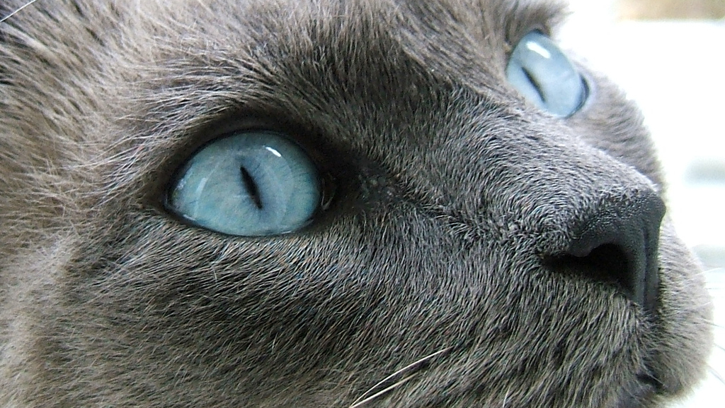
Notes:
Why the animals? E.g. familiars.

Slide 10
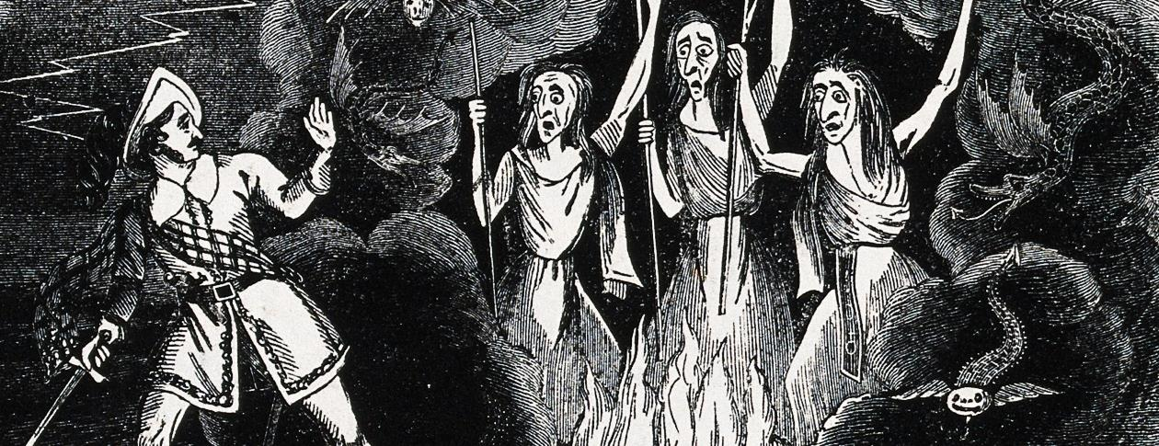
THE WITCHES

Slide 11
Understanding the Weird Sisters
Later in the play, Shakespeare will refer to them as the ‘weird sisters’.
They act as a prologue: they introduce the main themes and ideas of the play.
They also seem to – somehow – control the fate of the main characters, especially Banquo, and Macbeth.

Slide 12
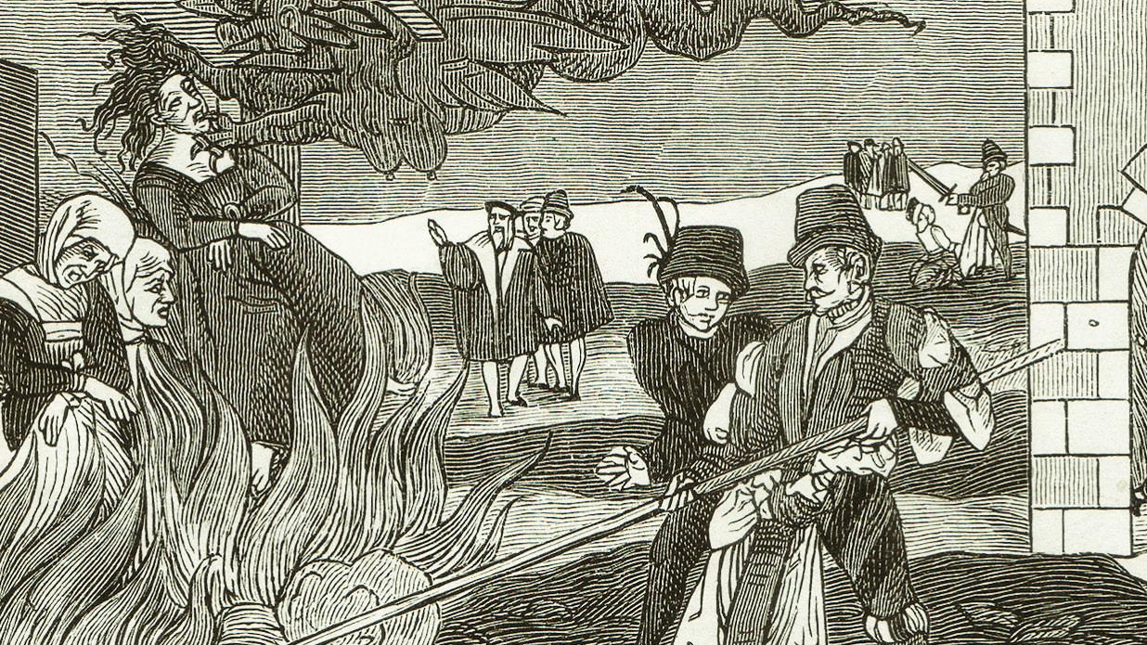

Slide 13
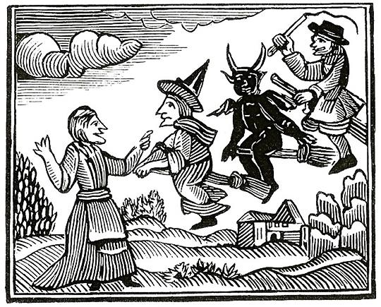
Starter – James I/VI
What do we know about how Jacobean society felt about witches?
Why do you think Shakespeare wrote a play that included witches?

Slide 14
The Supernatural
The supernatural is any force beyond scientific understanding or the laws of nature.
Ghosts, daemons, demons, spirits, devils, faeries, fairys, fairies, kelpies, angels, fates, witches, warlocks, poltergeists…

Slide 16
From start to 1.55 and 5.15 to end

Slide 17
Understanding the Weird Sisters
Questions – answering using PEE paragraphs.
It can be hard to get to grips with Shakespeare’s language – the best way is to look closely at what he is saying.
You should answer the following questions using PEE – Point, Evidence, Explain.

Slide 18
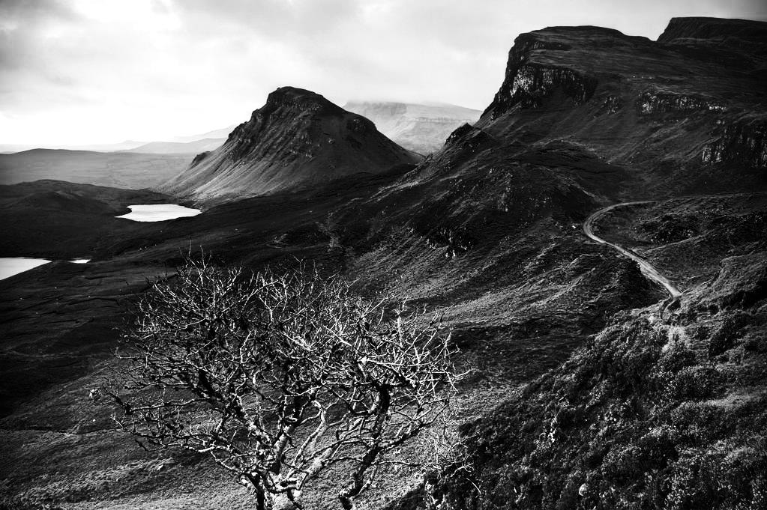
A desolate place…
Notes:
Skye!

Slide 19
Setting: Pathetic Fallacy
1. Where are the witches meeting? What does this suggest about them?
P – The witches meet in a empty, unpleasant location.
E – The stage direction says “a desolate place”.
E – This suggests they are living somewhere where normal creatures could not survive – that they are in the wildnerness.
Pathetic fallacy: a kind of ‘personification’ that gives human emotions to inanimate objects of nature; for example, referring to weather features reflecting a mood

Slide 20
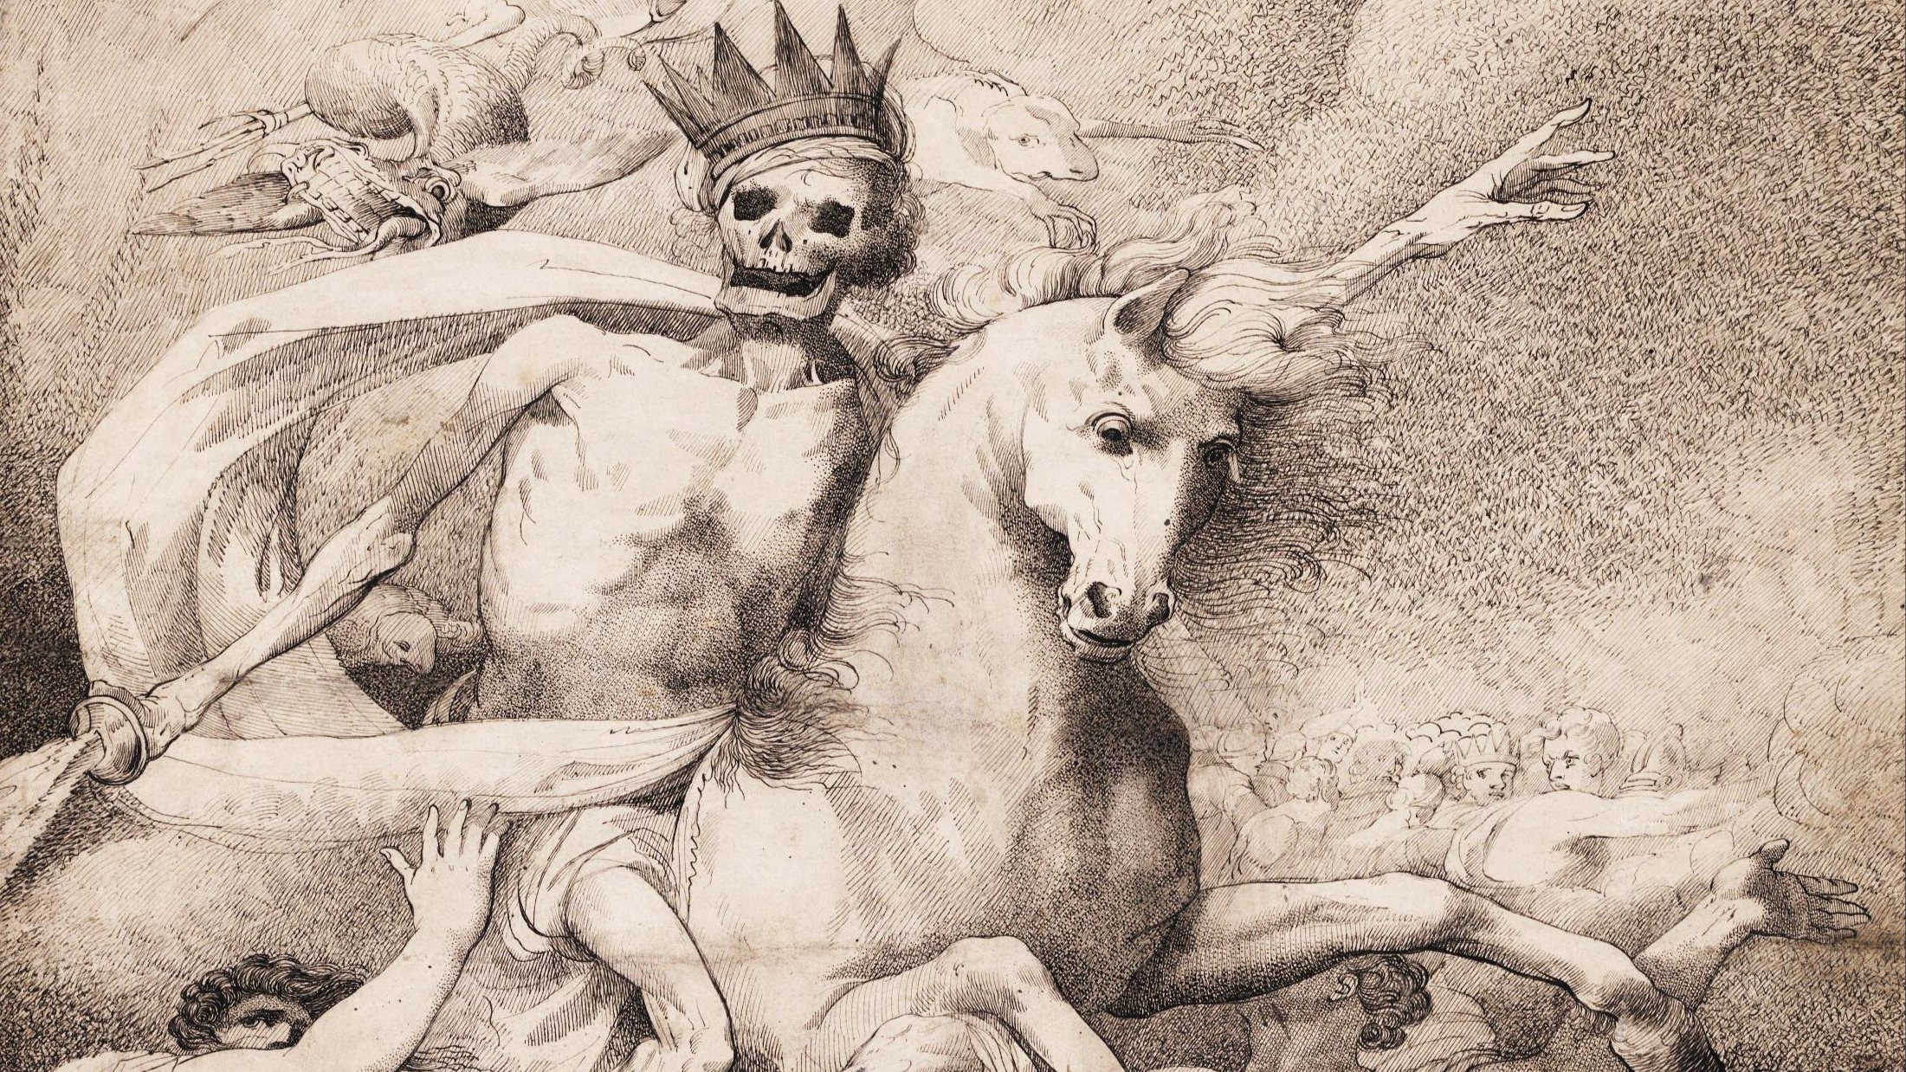
Themes…

Slide 21
Prologue: The beginning…
2. Why do you think Shakespeare begins the play with the witches? What themes does it introduce?
P
E
E
Theme: an idea that dominates or repeats and recurs in a work of art or literature. E.g. the theme of The Simpsons is Homer’s attempt to do the right thing for his family…

Slide 22
Prologue: The beginning…
2. Why do you think Shakespeare begins the play with the witches? What themes does it introduce?
P – Shakespeare introduces the themes of magic and evil in the very first lines of Macbeth.
E – We can see this clearly as he introduces three witches plotting
E – This shows that the play will be about strange, supernatural and dark events, with themes of death and magic.
Theme: an idea that dominates or repeats and recurs in a work of art or literature. E.g. the theme of The Simpsons is Homer’s attempt to do the right thing for his family…

Slide 23
Thunder, lightning, or in rain…

Slide 24
Special effects: mood
3. What is the weather like? What kind of mood does this set?
P
E
E
Mood: a mood is the feeling of a piece of writing, or a performance. A mood could be happy, sad, sombre, threatening, exciting, dangerous etc.

Slide 25
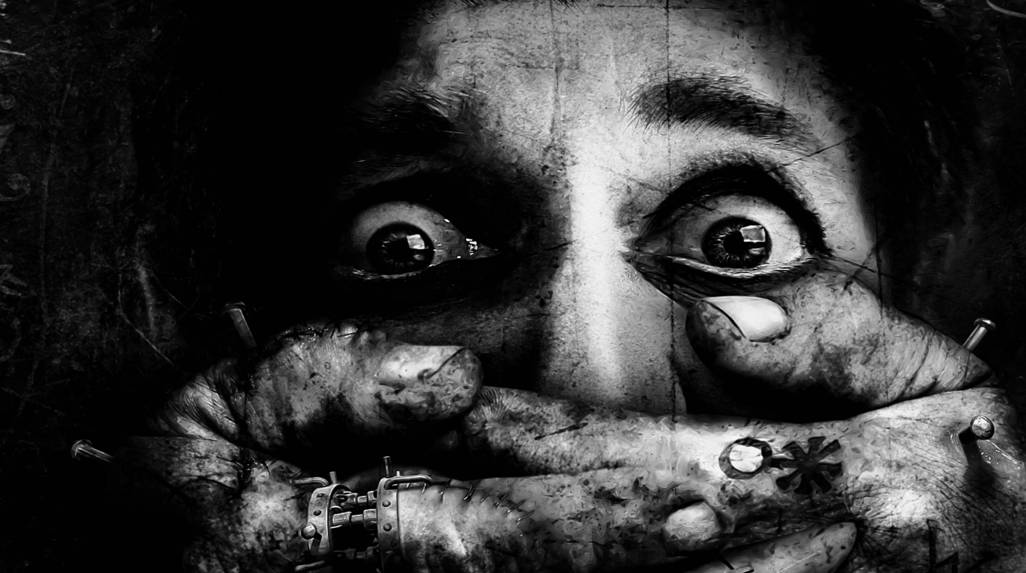
Speech and language

Slide 26
Speech and language
4. How do the witches speak? What is the effect of this?
P
E
E
Rhyme: a sound technique which matches the sound of words at the ends of lines in poetry or drama. It links ideas together in a rhythm. Used in romance, spells to show magic, or just for emphasis.

Slide 27
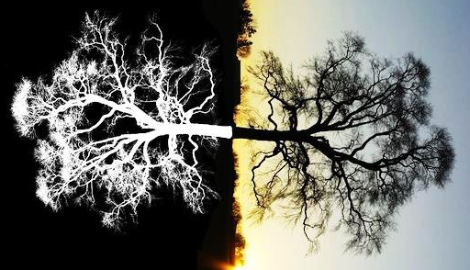

Slide 28
Speech and language
5. What paradox is spoken by the witches? What does this say about the world they live in?
P
E
E
Paradox: a contradictory idea. It might not make perfect sense, but it probably has a deeper meaning.

Slide 29
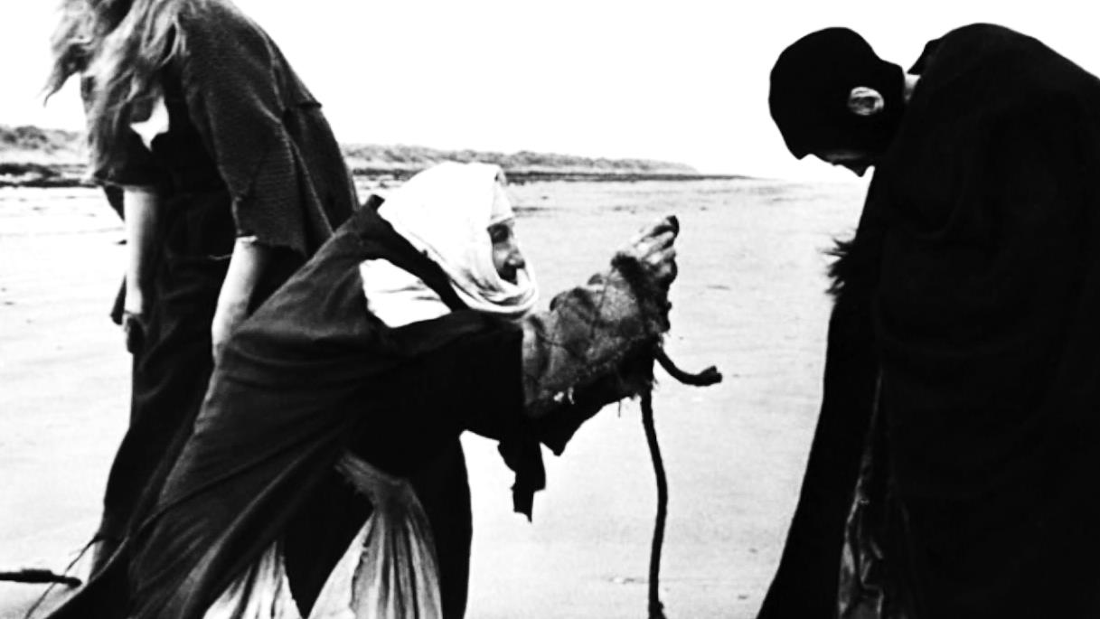

Slide 30
Predictions - themes
6. What does this scene tell you about the kind of play this will be?
P
E
E

Slide 32
Predictions - plot
7. Who do the witches want to meet? Where and when will they meet him? What is going on around the witches?
P
E
E

Slide 33
Putting it in context…
8. How do you think a Shakespearean audience would have reacted to the witches?
P
E
E
The supernatural: many people believe in things that can’t be explained: ghosts, poltergeists, spirits, witches, magic etc. In Shakespeare’s time science had hardly got going…

Slide 34
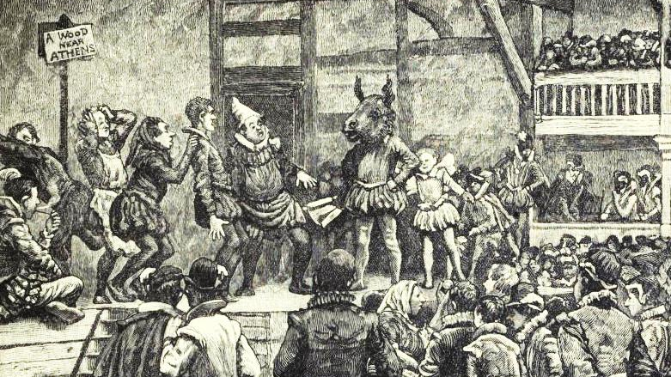
Notes:
Midsummer night’s dream

