Slide 1
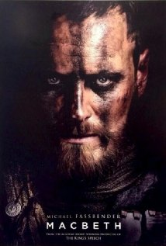
Macbeth
Learning Objective
Begin to understand how to read and engage with Shakespeare for GCSE

Slide 2
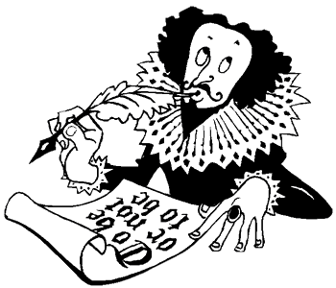
Starter
What do you know about Shakespeare?
What do you know about the play ‘Macbeth’.
Shakespeare
Macbeth

Slide 3
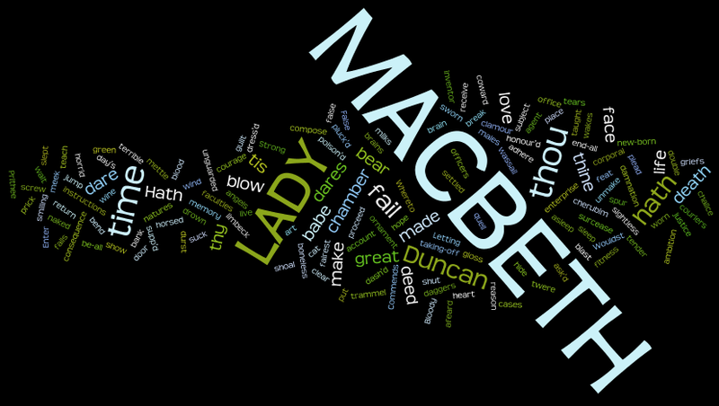
Shakespeare word cloud
Using the key words from the spider diagram create a Shakespeare word cloud for the first page of your yellow ‘Macbeth’ books.

Slide 4
LO: Begin to understand how to read and engage with Shakespeare for GCSE
Shakespeare can be quite intimidating for some people but IT IS NOT SCARY.
Today you are going to learn lots of techniques to help make understanding Shakespeare easier.

Slide 5
Imagery
‘Macbeth’ is full of imagery. Most of it is quite easy to understand.
What do you think is meant by this quotes and images? Be prepared to explain why.
‘O, full of scorpions is my mind,’
‘Look like the innocent flower, but be the serpent under’t’

Slide 6
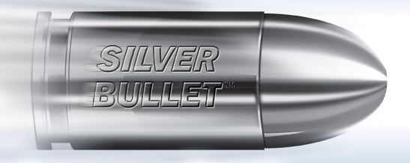
Silver bullet
Choose what you think is the most important word in each line of this important Macbeth soliloquy.
What does this combination of words tell you about the tone and mood of this part of the play? The first few have been suggested for you.
Is this a dagger which I see before me, The handle toward my hand? Come, let me clutch thee. I have thee not, and yet I see thee still. Art thou not, fatal vision, sensible To feeling as to sight? or art thou but A dagger of the mind, a false creation, Proceeding from the heat-oppressed brain? I see thee yet, in form as palpable As this which now I draw. Thou marshall’st me the way that I was going; And such an instrument I was to use. Mine eyes are made the fools o’ the other senses Or else worth all the rest; I see thee still, And on thy blade and dudgeon gouts of blood, Which was not so before. There's no such thing:

Slide 7
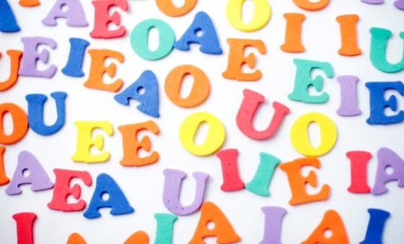
Remove the vowels
Remove the vowels from these Shakespeare lines then try to say the sounds out loud compare the tone and mood of the lines
“If it were done when ‘tis done, then ‘twere well It were done quickly”.
“If th’assassination Could trammel up the consequence and catch With his surcease, success, that but this blow“

Slide 8
Words you know that are like this…
Sometimes Shakespeare words are just like modern words.
What do you think these Shakespearean words could mean?
art
dost
doth
'ere
hast
'tis
'twas
wast
oft
ay
aught
nay
hie
are
do
does
before
have
it is
it was
were
often
yes
anything
no
hurry

Slide 9
And finally…
e at the end
Capital S at the beginning
A lot of people have trouble spelling Shakespeare.
How many words can you find in the word Shakespeare?
(kudos for any words with all 3 e’s)

Slide 10
Homework
Must: Finish Shakespeare word cloud or collage.
Should: Add colour to the word cloud or collage
Could: Carry out some research into ‘Macbeth’ and add more specific details on the word cloud or collage.

Slide 11
Macbeth
Learning Objective
Begin to understand how to read and engage with Shakespeare for GCSE

