Slide 1
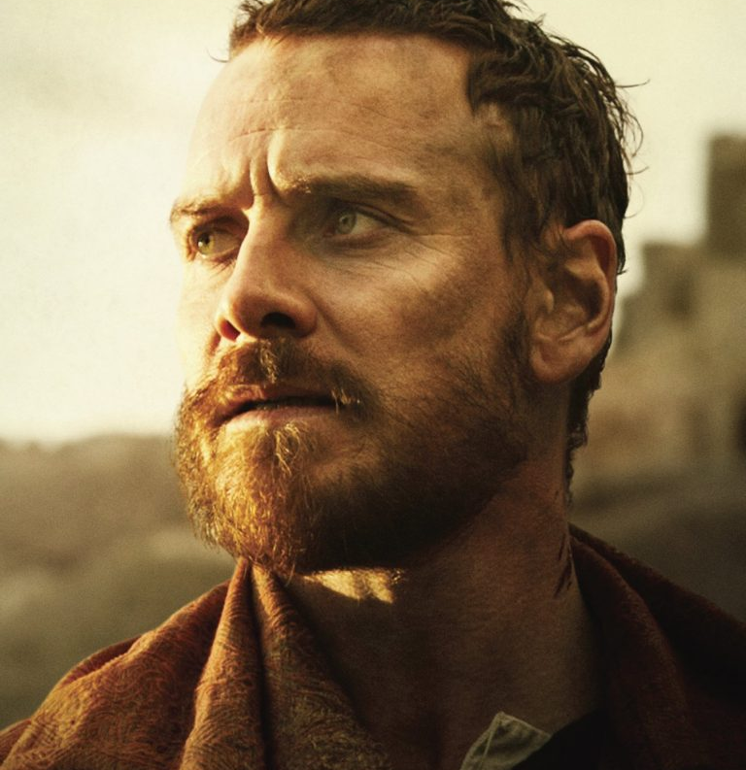
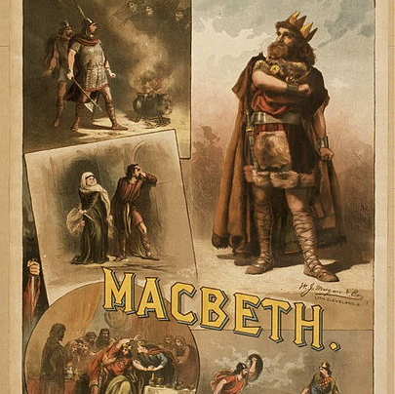
How to write about Macbeth

Slide 2
How to revise Macbeth?
When it comes to the exams you will need to revise the Shakespeare playing you are studying. The following sides are designed to help you with this revision.
It may seem hard but if you follow the advice as we go along with studying Macbeth, it will help you pass the exam.
You need to revise the characters looking at their motivation, how they interact with each other and their impact on the story.
You also need to consider the themes of the play and how certain scenes and characters show this theme throughout the play.

Slide 3
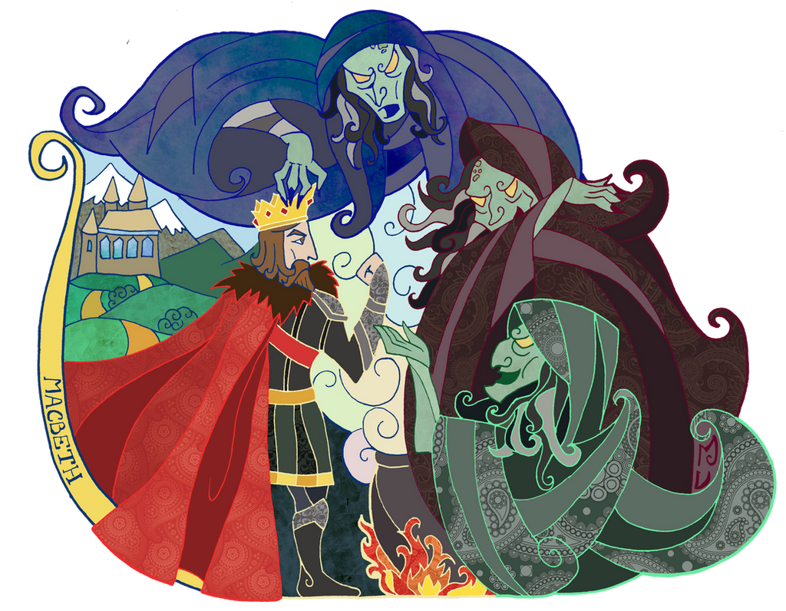
Characters
Characters in Macbeth you need to revise:
Macbeth
Lady Macbeth
Banquo
The Witches
Macduff
Lady Macduff
Duncan, Malcolm, Donalbain
For each character:
Consider why they are important to the play. Why do you think Shakespeare included this character?
Consider how the character changes in the play. How does this character develop as the play progresses?
Identify the key moments for this character. Which scenes do they play an important part in and do they have their own plot line? Look at your notes about the different themes in the play. Does thinking about a theme develop your understanding of a character?
Look at your notes about the historical context of the play. Does this develop your understanding of the character?
Pick at least three quotations for each character. As you are producing your revision notes, study cards, mind maps, etc., annotate your quotes to consider how Shakespeare has used language to tell us something about the characters.
How have different productions presented the character(s) in different ways?

Slide 4
Themes in Macbeth you need to revise:
Ambition
Supernatural/Witchcraft
Leadership/Kingship/Tyranny
Masculinity
Femininity
Guilt
Bravery/Courage
Themes
For each theme:
Consider why they are important in the play. Why do you think Shakespeare wants the audience to think about this issue?
Consider how the theme changes in the play. How does this theme develop as the play progresses?
Identify the key moments for this theme. Which scenes do they play an important part in?
Look at your notes about the different characters in the play. Does thinking about a character develop your understanding of a theme?
Look at your notes about the historical context of the play. Does this develop your understanding of the theme?
Pick at least three quotations for each theme. Annotate them to consider how Shakespeare has used language to tell us something.
Which do you think is the most important theme? Why?

Slide 5
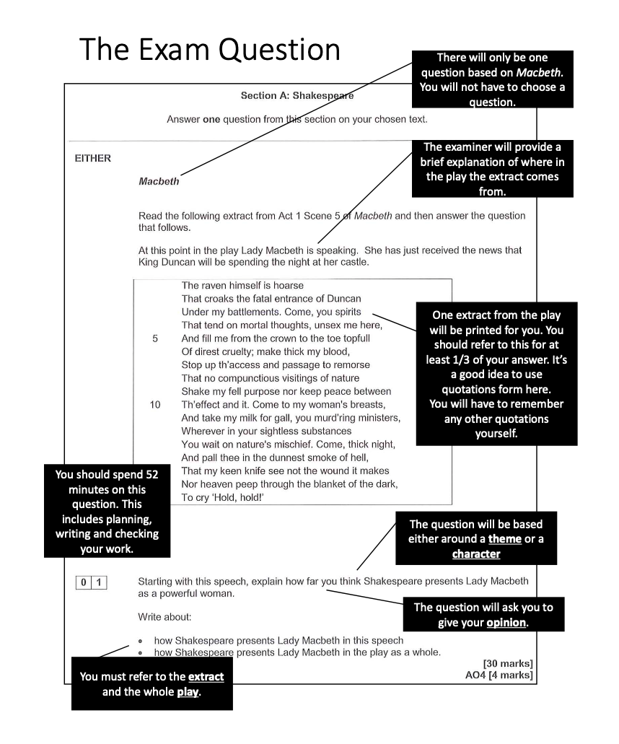
This is an example of an exam question.
Yours may not look exactly like this as we do a different board but it will be very similar and the advice still works!!
You will be given the extract and the question.
The question will be based around a theme or a character.
The question will ask you to give your opinion.
And – you must refer to the extract and the whole play!

Slide 6
How it will be marked
It will be marked out of 30 with 4 additional marks for SPAG
Marks | Area of assessment | What this means
26 - 30 | Conceptual Critique | - Convincing, critical, conceptual argument that drives response to task and text. (Detailed response that explores all ideas and concepts with evaluation based on reasoned arguments). - Analytical approach – precise references to illustrate argument
21 - 25 | Developed/balance analysis | - Consider different points of view/meanings/readings. - Develop ideas by linking to whole text/context/other references. - Offer tentative theories.
16 - 20 | Exploration of text as a construct/writer’s purpose | - Understand task and text and write a sustained response. - Explain effect of writer’s choice. - Use references effectively to support their point. (Quotes) - Show relative understanding of context. - Understand themes/ideas not specifically stated.
11 - 15 | Reasoned explanation | - Make relevant points about task and the whole text. - Focus of content of the text rather than the construction of it. - Explain what you think and why. - Use references to support ideas. (Quotes) - Identify more than one method used by the writer. - Are aware of themes and ideas.
6 - 10 | Supported understanding | - Attempts to have a clear opinion/point of view. - Attempts to use evidence. - Begins to be aware of writer/deliberate effects (e.g. mood)
1 - 5 | Narrative description | - Tell the story/what happens in the text. - Make some reference to the text. - Focus on narrative/plot.

Slide 7
Examples of answers
This would be an example of an answer in the 16 – 20 mark range. It is in response to the question on slide 5:
Starting with this speech, explain how far you think Shakespeare presents Lady Macbeth as a powerful woman.
Lady Macbeth describes Duncan’s entrance as ‘fatal’ straight after hearing he will be coming to her castle, which shows power because she is capable of making instant decisions. Lady Macbeth’s language in this extract suggests that she is calling for power from evil spirits to help give her strength to carry out the murder of Duncan. She wants to get rid of feminine side: ‘come to my woman’s breasts and take my milk for gall’. It is as if she thinks that she will only be able to carry out the act if her female side is replaced with ‘gall’ - something poisonous and evil. By using imperatives such as ‘come’ and ‘take’ Shakespeare might be showing her to be a powerful woman, capable of selling her soul to get what she wants. Later in the play she no longer appears powerful as she is overcome by guilt which makes her hallucinate.

Slide 8
Examples of answers
This would be an example of an answer in the 26 – 30 mark range. It is in response to the question on slide 5:
Starting with this speech, explain how far you think Shakespeare presents Lady Macbeth as a powerful woman.
Shakespeare clearly wants to show Lady Macbeth as a conflicted character. She is driven and ambitious and is willing to commit regicide to get what she wants. However, she also struggles with a guilty conscience and is ultimately psychologically broken by her remorse. At the start of the play she defies the contemporary fear of witchcraft and calls on evil spirits to ‘unsex me here’ and ‘take my milk for gall’. On one hand, Shakespeare’s use of imperatives highlight her strength and determination. On the other, they illustrate a desperation in the character. This need to change herself and remove the caring, maternal ‘milk’ may in fact foreshadow her inability to ‘stop up th’ access and passage to remorse’. Although Lady Macbeth may be presented as strong and a key catalyst for Duncan’s death at the start of the play, by the end she is weak and overcome by guilt. She seems to be admitting this vulnerability when she imagines seeing blood on her ‘little’ hand in Act 5, Scene 1. Ultimately, Shakespeare is presenting a character who cannot free herself from Christian guilt, even with the help of the supernatural. She may be powerful, but she is not free of remorse and this is her downfall.

Slide 9
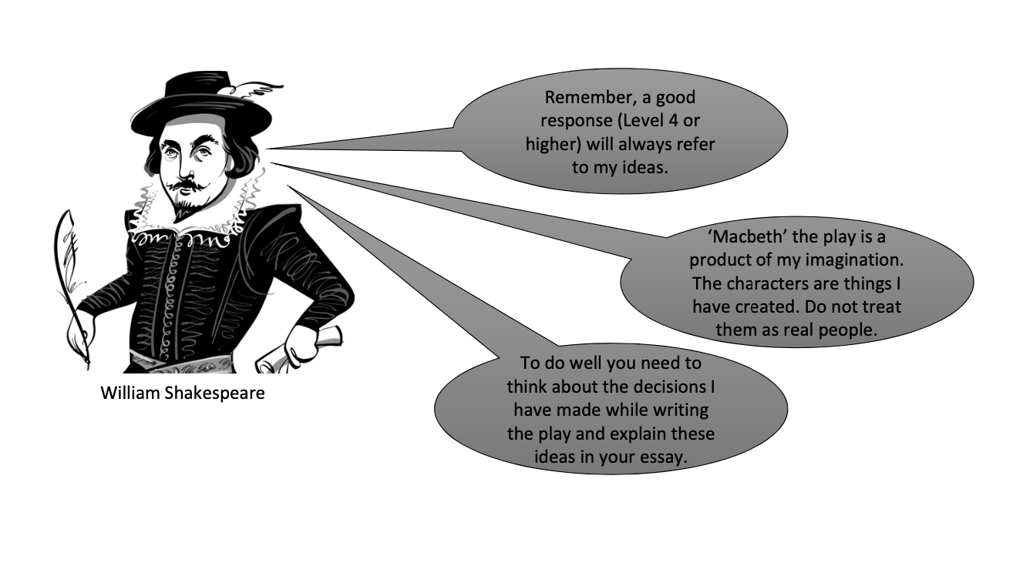
How to answer the question
Read the question carefully. Identify which characters or themes you need to focus on.
Think back to your revision notes. What is your opinion about this character or theme?
Read the extract and pick out 2/3 quotations you would like to focus on. Annotate these to consider how Shakespeare has used language/structure/form for effect.
Identify other moments in the play that you think are important in exploring your opinion about the characters/themes. You should try to remember quotations.
Consider what information about historical context will help you explore your opinion.
Order your notes into 3 – 5 clear points you are going to make about the character/theme.

Slide 10
Sentence Starters
Shakespeare introduces the character as …
Shakespeare uses ...
Shakespeare wants to …
Shakespeare communicates …
Shakespeare intends to …
Shakespeare decided to start with …
Shakespeare presents Macbeth as …
The play closes/opens with …
Shakespeare wants the audience to think that …
The character is presented as … by Shakespeare to …
Shakespeare uses negative language because he wants to show …
Shakespeare wants the audience to understand …
The character embodies/represents/ symbolizes …
Shakespeare illustrates the idea through …
The concept is explored through the use of …
When Shakespeare uses … he wants to convey the idea that …
(Character) is portrayed as …
A sense of … is created by Shakespeare by …
The entrance of (character) symbolizes …
We already know that … because …
The audience is aware of …
When the reader discovers …
Shakespeare uses dramatic irony when …
The use of imperative/questions suggest …
This character is first presented as …
This is a turning point because …
Shakespeare may be trying to/could be trying to show …
Shakespeare is influenced by …
The audience may interpret this as …
Shakespeare challenges the audience to …
The concept of …
The writer’s concept …

Slide 11
Now have a go …..
Read the following extract from Act 1, Scene 3 and then answer the question that follows.
At this point in the play Macbeth and Banquo have just spoken with the Witches. Macbeth has been told he will be King.
Macbeth (aside)
Two truths are told,
As happy prologues to the swelling act
Of the imperial theme. (to ROSS and ANGUS) I thank you gentlemen.
(aside) This supernatural soliciting
Cannot be ill, cannot be good. If ill,
Why hath it given me earnest success,
Commencing in a truth? I am thane of Cawdor.
If good, why do I yield to that suggestion
Whose horrid image doth unfix my hair
And make my seated heart knock at my ribs,
Against the use of nature? Present fears
Are less than horrible imaginings.
My thought, whose murder yet is by fantastical,
Shakes so my single state of man
That function is smothered in surmise,
And nothing is but what is not.
Starting with this extract, write about how Shakespeare presents witchcraft and the supernatural.
Write about:
How Shakespeare presents Macbeth’s reaction to the witches
How Shakespeare presents witchcraft and the supernatural in the play as a whole.

