Slide 1
Act 1 Scene 2
The Scottish _______, led by Macbeth and Banquo, are fighting a Norwegian _______and a ______ army led by Macdonald. Duncan, the ______of Scotland, is _______ with Macbeth’s brave ______and decides to make him Thane of ______.
King Army rebel Cawdor impressed invasion fighting

Slide 2
Act 1 Scene 2
Character
Role
Duncan
Malcolm
Captain
Lennox
Rosse
King Duncan’s son
These two are Thanes, and will eventually turn against Macbeth.
A popular and honoured king of Scotland
A wounded leader of Duncan’s army
What is a THANE? A: a man, often the chief of a clan, who held land from a Scottish king.

Slide 3
Match ‘em up!
kern | bravery (again Shakespeare has used personification)
gallowglass | servant
Fortune | jaw
brandished steel | Navel / belly button
‘smoked with bloody execution’ | split open
Valour | foot soldier armed with sword and shield
minion | a soldier fighting just for the money
unseamed | it is so cold that the blood on the sword is creating steam just as breath does in cold weather
nave | Macbeth is waving his sword threateningly
chaps | fate (Shakespeare’s imagery sees fate as a woman who is only flirting with the rebels)

Slide 4
In the 1600s English was different…
kern | foot soldier armed with sword and shield
gallowglass | a soldier fighting just for the money
Fortune | fate (Shakespeare’s imagery sees fate as a woman who is only flirting with the rebels)
brandished steel | Macbeth is waving his sword threateningly
‘smoked with bloody execution’ | it is so cold that the blood on the sword is creating steam just as breath does in cold weather
Valour | bravery (again Shakespeare has used personification)
minion | servant
unseamed | split open
nave | Navel / belly button
chaps | jaw

Slide 5
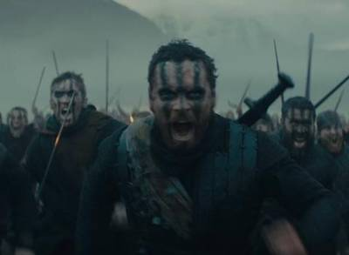
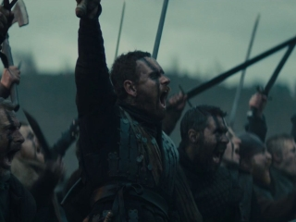
The Captain’s Speech
Starter/Recall: What is the Captain’s speech about? Who is he talking to? Why has Shakespeare included this in the play?

Slide 6
The Captain’s Speech
Driving question: how does Shakespeare present Macbeth in the Captain’s speech?

Slide 7
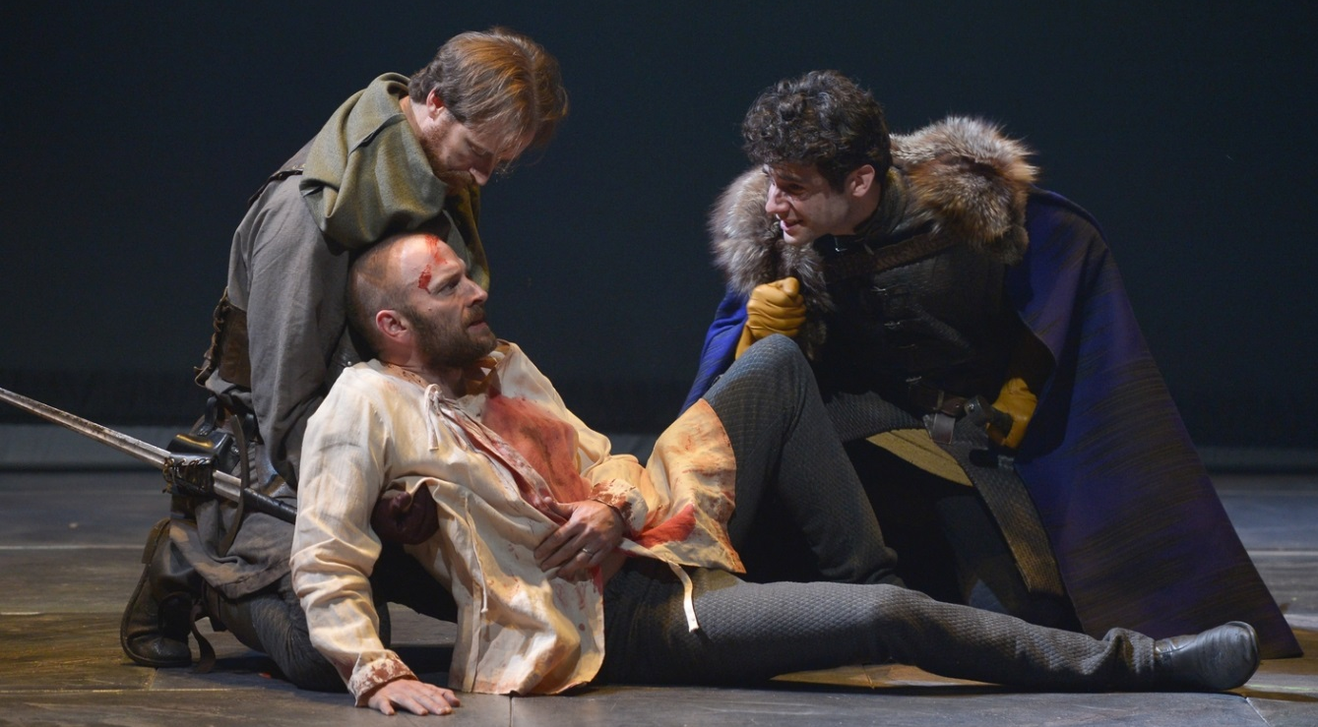
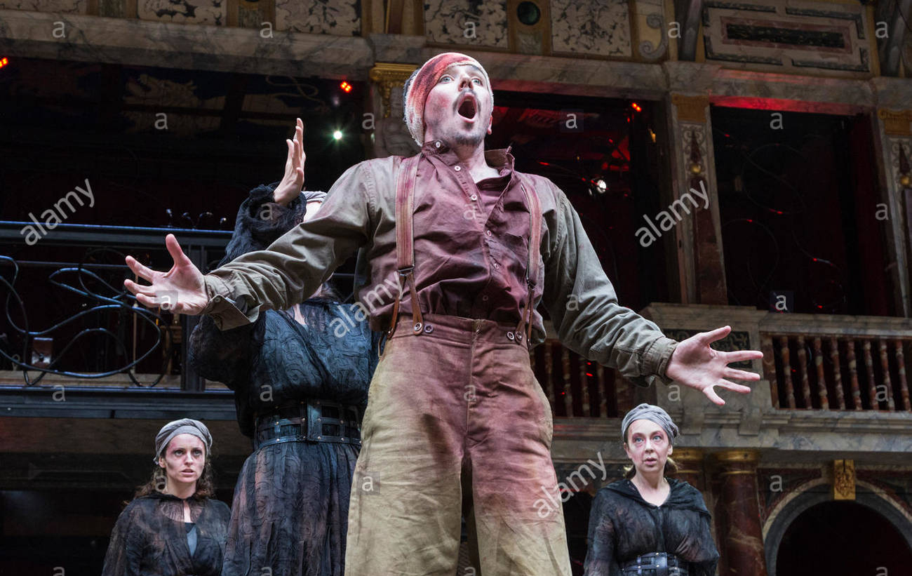
If you were Director…
Is the captain in pain and struggling to speak?
Is he faint and breathless?
Is he excited and saying the speech quickly?
Is he laughing about the death of the rebel, which means the rebels will be crushed and the battle over?
Why? What does the captain think of Macbeth? Is he impressed, awed, disgusted? Does he admire him or does he think Macbeth is a disgrace?

Slide 8
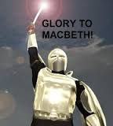
How is Macbeth presented?
What words suggest Macbeth is heroic?
What words suggest he is simply violent and bloodthirsty?
Is there a difference?

Slide 9
How does Shakespeare present Macbeth in the captain’s speech?
Shakespeare’s use of language suggests that the captain would be… because…
The captain, and other soldiers … (explain what they think of Macbeth with a quote). This would encourage the audience to think Macbeth is… because…
Some of the language Shakespeare uses gives us the impression that Macbeth is… for example… this suggests / implies / tell us that…
However, Shakespeare’s language also tells us that Macbeth is … for example… this suggests / implies / tell us that…

Slide 10
Paragraph 1
Shakespeare’s use of language suggests that the captain would be injured and struggling to speak through his pain. He uses harsh consonants: “kerns and gallowglasses” or “choke their art.” These harsh consonants would make the captain sound as if he is coughing out his words. He would be struggling to speak, but doing it because he felt so strongly about Macbeth’s bravery. This would make the audience think that Macbeth is well-respected and admired by the highest ranking members of the army, so we must admire him as well.

