Slide 1
Macbeth
Learning Objective
Read and understand Act 5 Scene 8 and 9

Slide 2
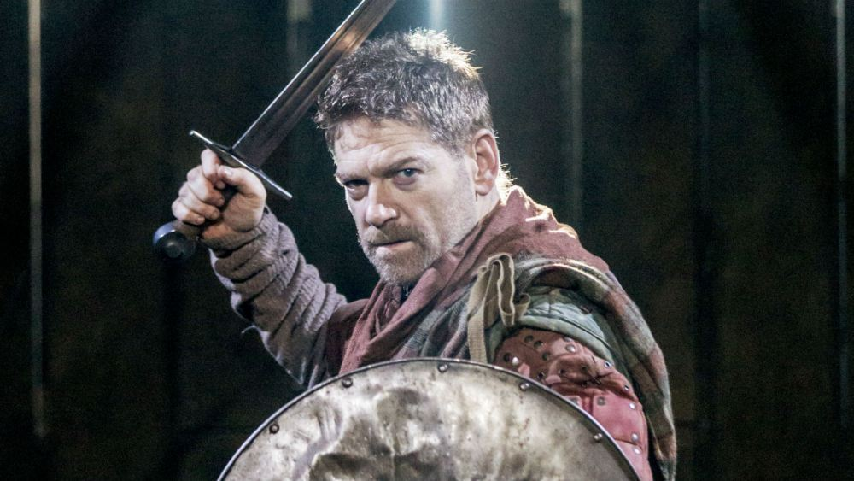
Read Act 5 Scene 8

Slide 3
‘I will not yield’.
The end of Scene 8 are Macbeth’s last lines and he chooses life over death here. How would Macbeth deliver this line? Consider different ways of acting it out. Think about the lasting impression of Macbeth you would want to leave with the audience: is his death brave and dignified or cowardly and abject?

Slide 4
Review the play
What are the 10 most important key events of the whole play? Discuss as a class what the pivotal moments are.
Find the most influential line within that event.
What are the 10 most important quotations of the play?

Slide 5
Task
Must: Write a summary of ‘Macbeth’ in exactly 150 words
Should: Cut the summary down to 75 words
Could: Cut the summary even further to 50 and then 10 words. Select one word that captures the most important element of the play.

