Slide 1
‘Macbeth’ Themes in Macbeth

Slide 2
Lesson Objective
To explore the themes of Macbeth.
Success Criteria
To learn about the themes of ambition, gender and fate/free will.
To discover other themes in Macbeth.

Slide 3
Macbeth Meaning
What do you think is the overall message of Macbeth?
What makes you think this?
NOTE: You may have a different idea from other people in your class – that’s fine!

Slide 4
Themes
It is possible to pick out many different themes in Macbeth, each of which links to a different message that the audience might take from the play.
People have different views about what the overall message of Macbeth is and what the main themes are. This is understandable as any work of art will be interpreted differently at different times and by different people.
We are going to look at just three themes:
Ambition
Gender
Fate/Free Will

Slide 5
Ambition
Ambition has a large role to play in the story. If it wasn’t for the ambition of Macbeth and Lady Macbeth, nothing would have happened!
Look at your quotes sheet and fill it in to analyse the quotes on ambition. Then use what you have written to answer the questions below:
Was Macbeth ambitious for himself anyway, or was the seed of ambition planted by the witches?
Is anyone else in the play ambitious, other than Macbeth and Lady Macbeth?
Does Shakespeare portray ambition itself as evil?
Why might a Shakespearean audience have felt uneasy at the notion of ambition?
Remember to support your answers with quotes.

Slide 6
Gender
The complex relationship between Macbeth and Lady Macbeth makes gender an important theme in the play. At first, Lady Macbeth appears to ‘wear the trousers’ in their relationship, even asking the spirits to ‘unsex’ her. She accuses Macbeth several times of not being a ‘proper man’.
The witches are also significant in a discussion of gender. Despite their beards, they are female and yet they meddle in the affairs of men with far-reaching consequences.
Look at your sheet and fill in your analysis of the quotes there. Then use what you have learned to answer the following questions:
Thinking about Lady Macbeth and the witches, do you think Shakespeare portrays women as evil?
What is ‘manliness’ as seen in Macbeth?
What does it say about how women were viewed at the time that Lady Macbeth needs to be ‘unsexed’ in order to turn herself to evil deeds?

Slide 7
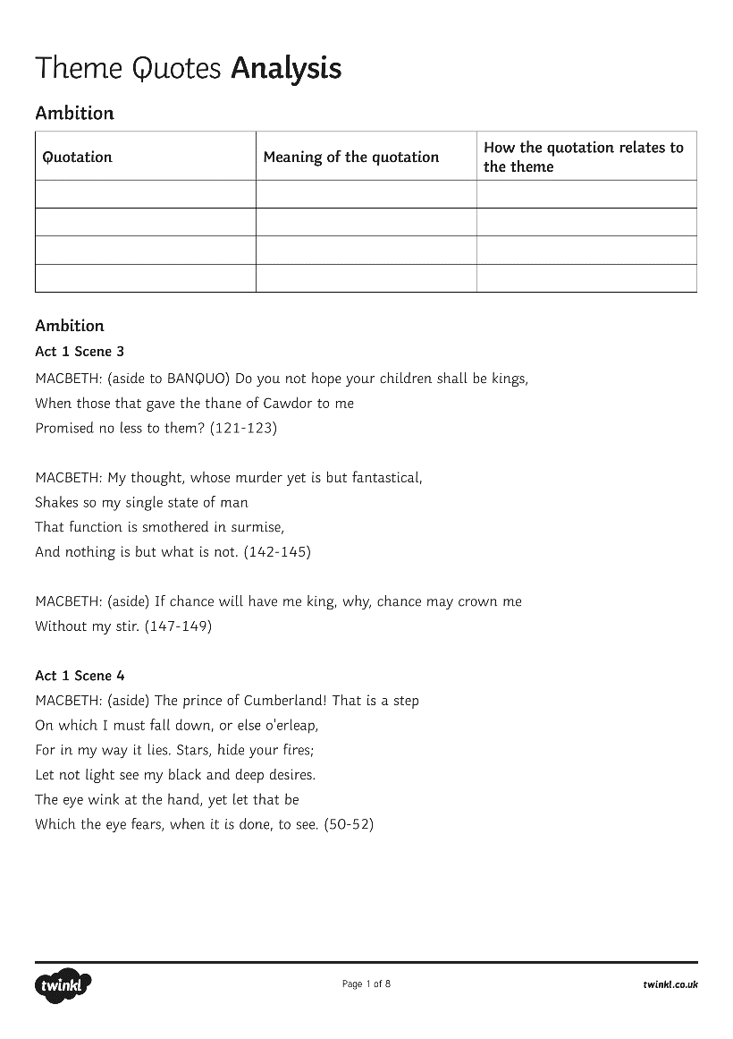
Fate/Free Will
The witches’ prophecies suggest that the future is fixed and that fate will make things happen a certain way, whatever action people take. This way of thinking suggests that it doesn’t matter what men and women do; the future cannot be changed.
On the opposite side is a belief in free will – the belief that humans choose their destiny through their actions and that the future is not fixed but created from an infinite number of possibilities as we go through life.
Fill in your sheet to analyse the quotes and then use your work to answer the questions below:
Are the witches wrong to tell Macbeth and Banquo their prophecies?
Is Macbeth the victim of fate?
If the witches were taken out of the story, would things have turned out differently?

Slide 8
Your Turn
Identify at least one other theme from the options given below. Explain how this theme is portrayed in the play and find five quotations which link to it.
Possible other themes:
Guilt
The Supernatural
Kingship
Power
Violence
Appearance and Reality
Children

Slide 9
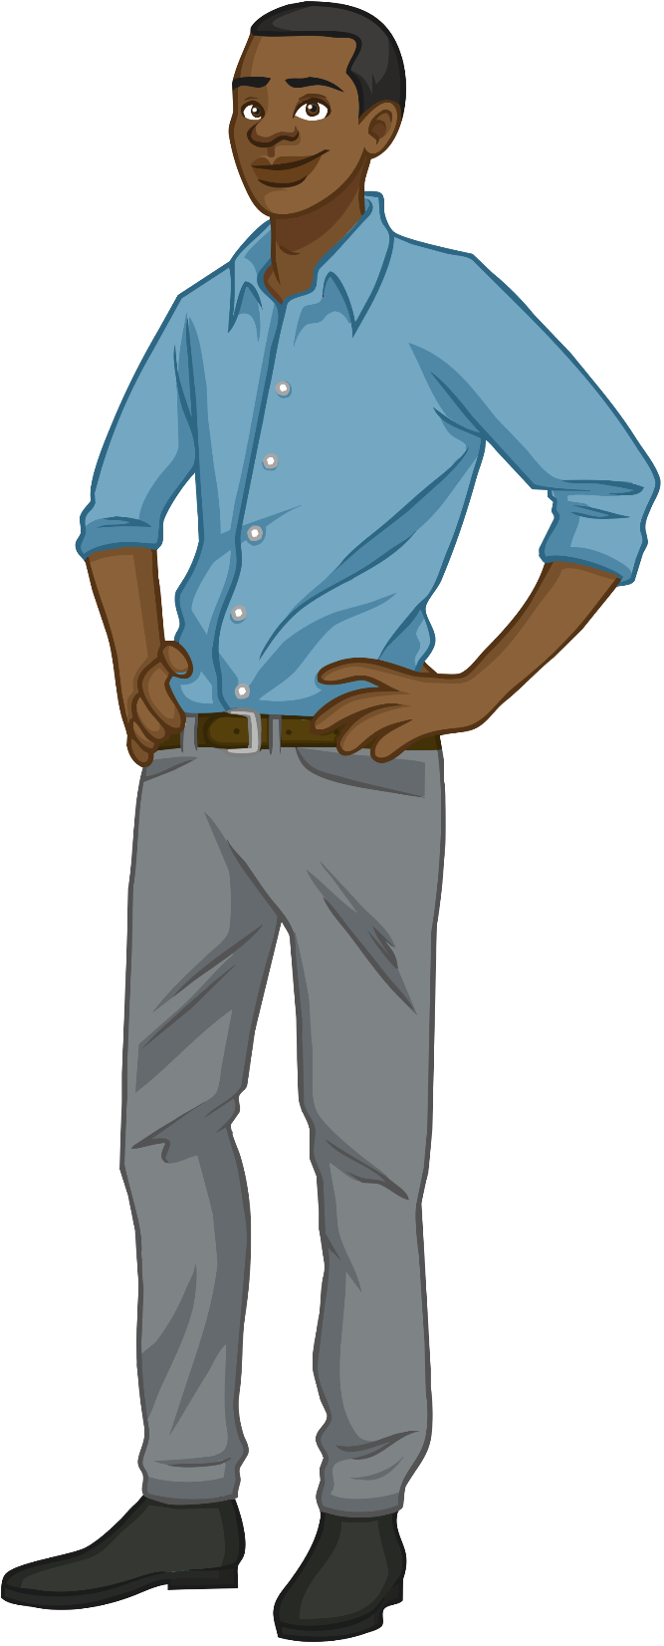
Discuss
Feed your ideas back to the class and listen to the ideas that others have about the different themes in Macbeth.

