Slide 1
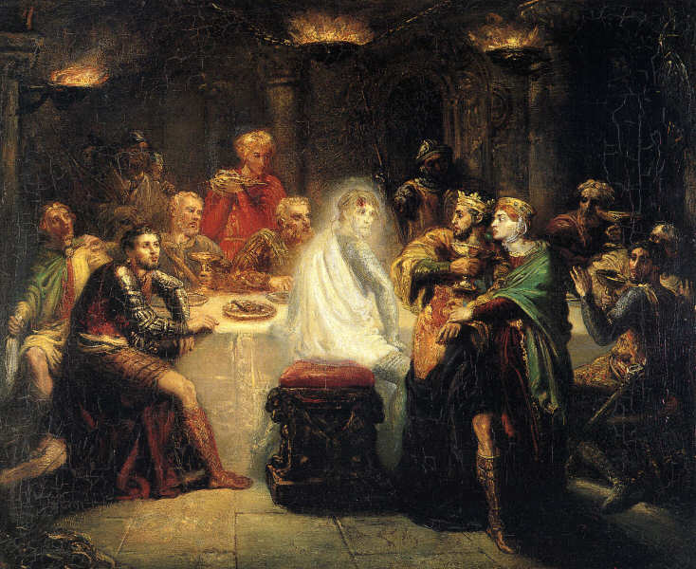
Is Macbeth a tragedy?
Macbeth and Tragedy
Tragedy: “a play dealing with tragic events and one with an unhappy ending, especially involving the downfall of the main character.”
Make notes to answer this question. Refer to specific parts of the play. Refer to specific quotes within your evaluation.
Notes:
Play as students come in: https://www.youtube.com/watch?v=qOMU5KOVoJ8

Slide 2
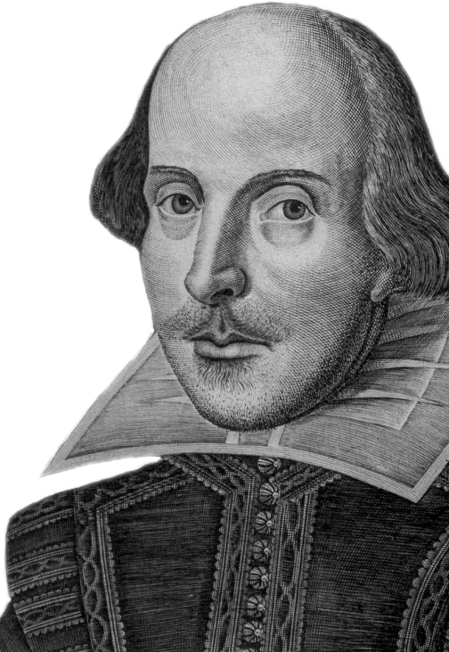
Learning outcomes
To describe the key elements of Shakespearean tragedy
To explain how much of a tragedy is Macbeth
To evaluate how Shakespeare uses elements of tragedy to impact on the audience in Macbeth

Slide 3
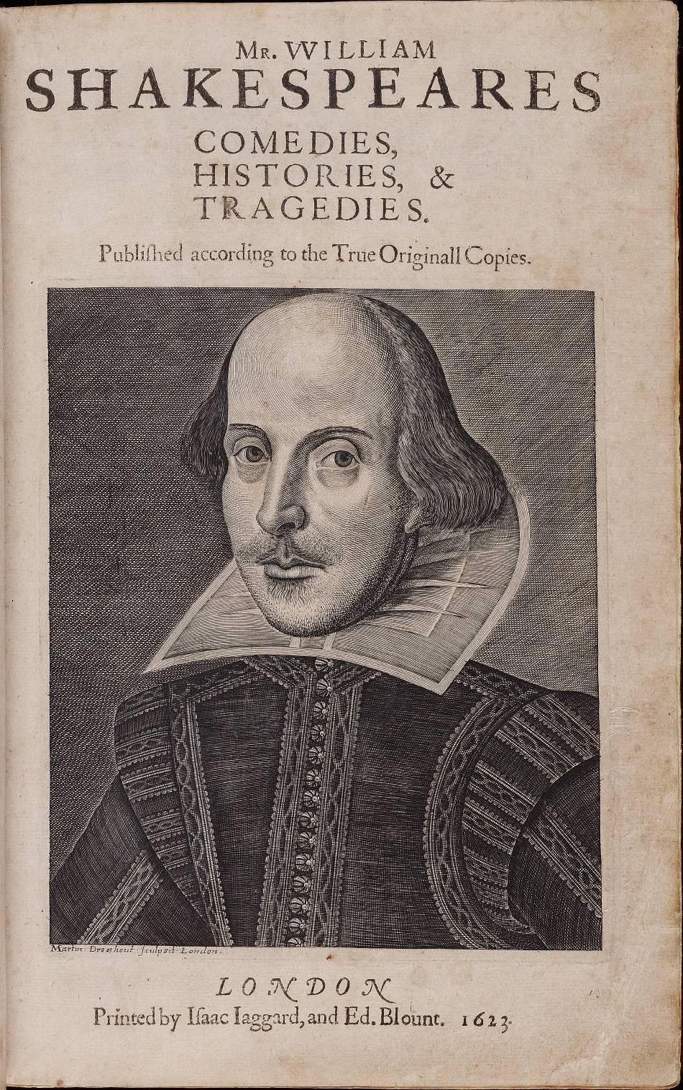
Shakespeare and Genre
Shakespeare’s plays are normally broken down into three genres: Comedies, Histories and Tragedies.
However, many of his plays subvert genre conventions and expectations.
Macbeth is no exception…

Slide 4
So what exactly is a Shakespearean tragedy?
https://www.youtube.com/watch?v=NWbxpK90I_Q
https://www.youtube.com/watch?v=TqwEThbjhGE
Watch the clips (in brower) and make notes on:
The key elements of Shakespearean tragedy
Which ones you think you can see in Macbeth
How Shakespeare manipulates the genre to impact on his audience
Notes:
https://www.youtube.com/watch?v=NWbxpK90I_Q

Slide 5
Tragic element | What is means
Tragic Hero | A main character cursed by fate and possessed of a tragic flaw.
A Struggle Between Good and Evil | This struggle can take place as part of the plot or exist within the main character.
Hamartia (Tragic Flaw) | The fatal character flaw of the tragic hero.
Tragic Waste | The good being destroyed along with the bad at the resolution of the play. Often played out with the unnecessary loss of life, especially of "good guy" characters.
External Conflict | This can be a problem facing the hero as a result of the plot or a "bad guy" character.
Internal Conflict | The struggle the hero engages in with his/her fatal flaw.
Catharsis | The release of the audience's emotions through empathy with the characters.
Supernatural Elements | Magic, witchcraft, ghosts, etc.
Lack of Poetic Justice | Things end poorly for everyone, including the "good guys."
Comic Relief | One or more humorous characters who participate in scenes intended to lighten the mood.
Each of these is considered a key element of tragedy.
Go through the list and decide which of these you think applies to Macbeth
How much of a tragedy is Macbeth? Why?
Research another of Shakespeare’s tragedies and comment on the similarities and differences. Why might these be the case?

Slide 6
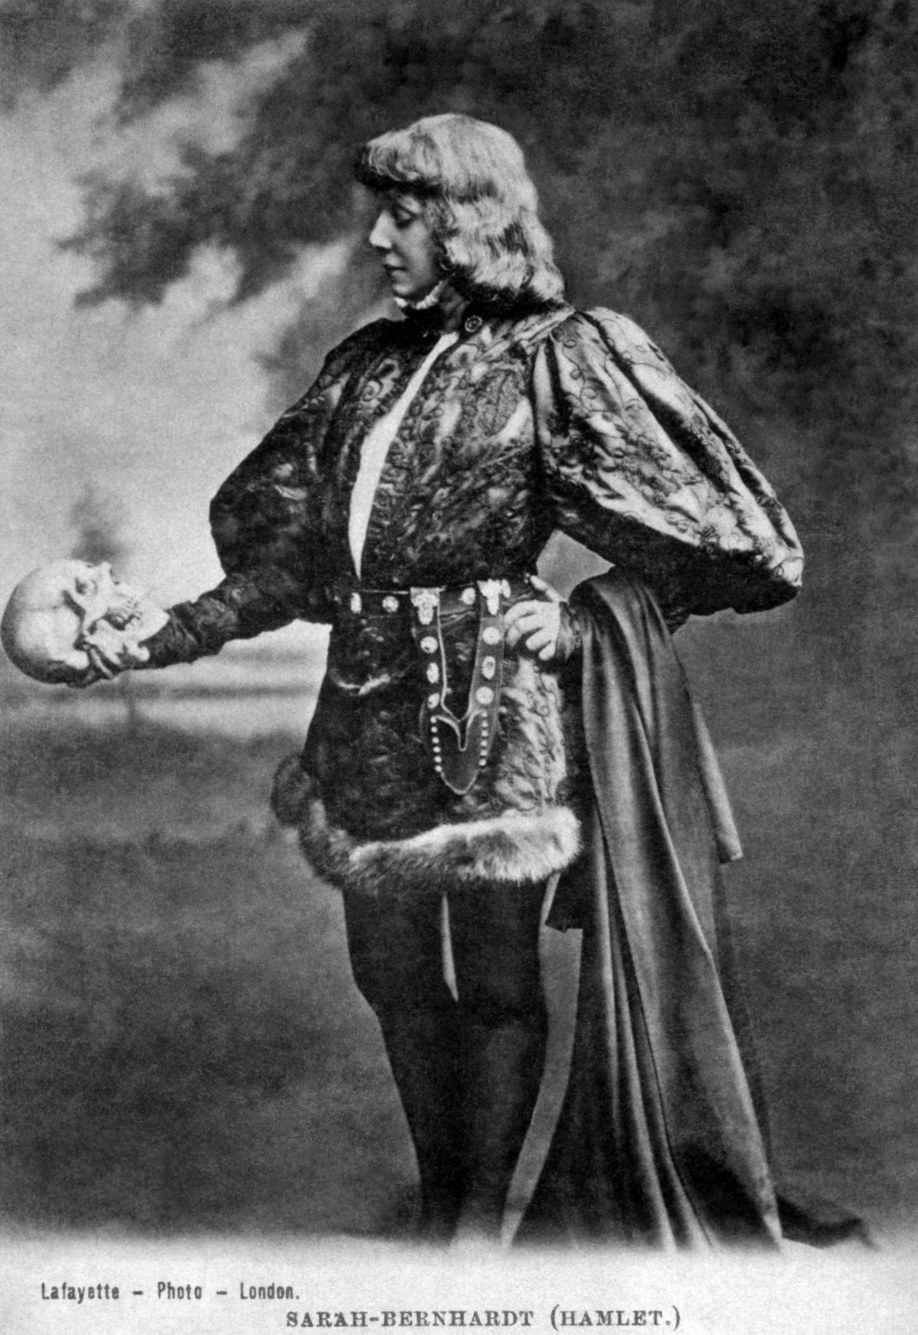
Is Macbeth a tragic hero?
Yes because…
No because…
Add in relevant parts of the play
Add in quotes and analysis of language

Slide 7
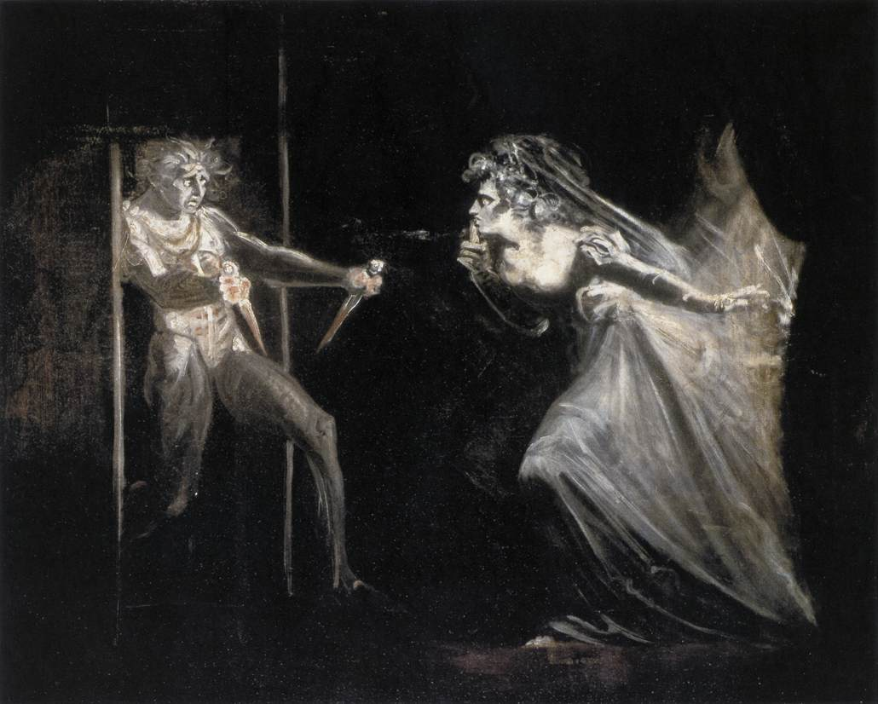
Is Macbeth a tragic hero?
A tragedy is the story of a great person with one fatal flaw which leads to his downfall. Macbeth had everything he needed in life. He was a hero, popular with the king, given new honours after being successful in battle. Then the witches put an evil ambition into his mind.
Shakespeare's Macbeth is a tragic hero because he was not controlled by the witches, but made his own decisions with regards to the killings of Duncan, Banquo and the Macduff family.
Macbeth may be seen as tragic hero because, although his rise to the throne is already predestined or predicted, he makes his own decisions in order to achieve those prophecies. The witches reveal Macbeth will become king, and of course this happens. However, Macbeth is the one who comes up with the idea of murdering the king in order to become king himself, this is NEVER suggested by the witches themselves. Macbeth himself admits there are lots of reasons to protect Duncan and only one to actually kill him: ambition.
For some, Macbeth is no hero at all. Therefore he cannot be a tragic hero, although he begins the play as a celebrated warrior and loyal servant to Duncan.

Slide 8
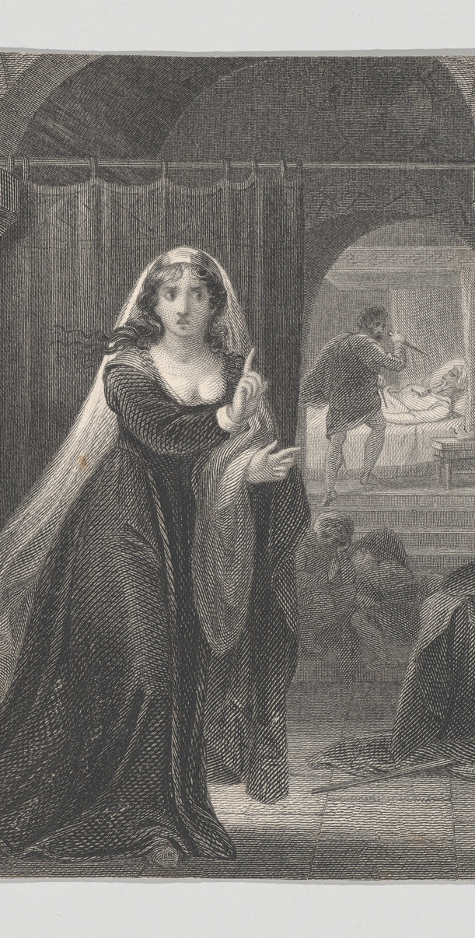
Is ‘Macbeth’ about Good v Evil?
Consider:
The ways that Banquo, Macduff, Malcolm and Duncan are portrayed in the play
The ways that Macbeth and Lady Macbeth are portrayed in the play
Why we have so many soliloquies and asides showing us Macbeth’s perspective
Why Lady Macbeth eventually loses her sanity and why Macbeth is eventually killed.
Work in groups to make notes on this topic and be prepared to share your ideas
Refer to specific quotes in your notes
Explain how Shakespeare exploits structure to emphasise the battle between Good and Evil.

Slide 9
It could be argued that ‘Macbeth’ is a type of allegory
Lady Macbeth and Macbeth are representations of evil and corrupted goodness. They rejected goodness for the sake of their own ambitions.
Banquo, Duncan, Malcolm and Macduff are fundamentally good people – they fight for justice and fairness. Banquo is slaughtered because of Macbeth’s paranoid, but Malcolm and Macduff are victorious by the end of the play.
The rightful heir to the throne regains power at the play’s conclusion.
Therefore the play works quite well as an allegory for the struggle between good and evil.
Additionally, it pushes the notion of the ‘divine right of kings’ to the fore – a concept that was at the heart of King James’ philosophy on the monarchy.

Slide 10
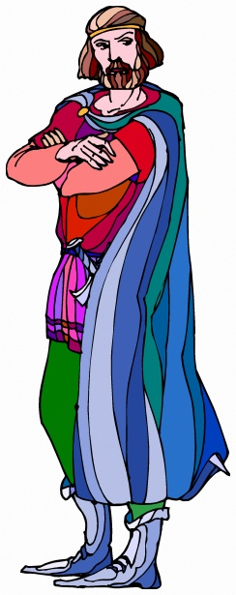
Hamartia is the Greek word for “sin” or “error”, which comes from the verb hamatanein, meaning “to err” or “to miss the mark”.
Usually every hero falls due to a flaw in his or her character. Famous critic A. C. Bradley wrote: “The calamities and catastrophe follow inevitably from the deeds of men and the main source of these deeds is character.”
Because of their fatal flaw, the hero falls from a high position, which leads to his/her unavoidable death.
Examples in other plays:
In Hamlet the main protagonist’s inability to make decisions and act on them – ultimately, his procrastination, leads to his death.
In Othello, it is the main protagonist’s jealousy and accompanying all-encompassing rage that sees Othello lose his life.

Slide 11
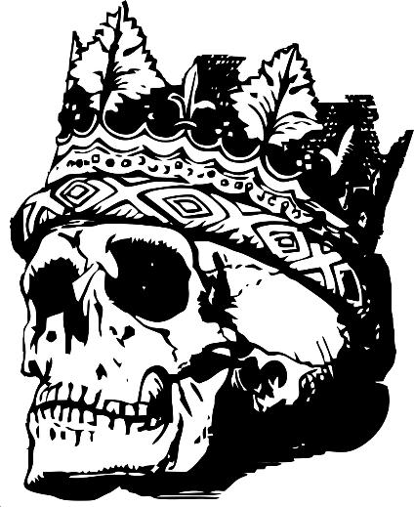
Does Macbeth contain tragic waste?
The good being destroyed along with the bad at the resolution of the play. This particular element is more applicable to a play like Hamlet where most of the major characters are killed within the last scene of the play. However, in Macbeth we do see Duncan, Lady Macbeth, Banquo, Lady Macduff and Macbeth lose their lives before the end, yet some good characters triumph: Macduff and Malcolm.

Slide 12
Does Macbeth contain external or internal conflict?
External conflict: Macbeth has to defeat Malcolm’s army after it becomes apparent Macbeth killed Malcolm’s father to get the throne.
Internal conflict: Macbeth is conflicted by how he should deal with events after he has killed Duncan. Eventually he decides not to think about what he should do but simply do whatever he thinks must be done. Additionally, Macbeth is conflicted over whether to kill Duncan in the first place or not.

Slide 13
Does Macbeth contain catharsis?
This is an emotional release for one of the characters. Whilst we know what the main characters think, Macbeth isolates himself from his wife and everyone else, so this element is not necessarily applicable to Macbeth.
Does Macbeth contain the supernatural?
Magic, witchcraft, ghosts, and so on. Plenty of these in this play!

Slide 14
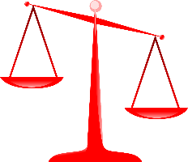
Does Macbeth contain a lack of poetic justice?
There is a sense of justice in this play, in that Malcolm becomes king as he should have been after his father died. However, the loose end of Fleance is left unresolved by the end.
Does Macbeth contain comic relief?
The Porter Scene in Act 2 Scene 3 is a great example of comic relief, where despite the audience witnessing deception and murder we are still treated to jokes about drinking and the effects of alcohol.

Slide 15
Plenary: Acrostic
Tragic hero
R A G E D Y
To describe the key elements of Shakespearean tragedy
To explain how much of a tragedy is Macbeth
To evaluate how Shakespeare uses elements of tragedy to impact on the audience in Macbeth

